Slide 1

ΚΔΑΠ ΜΕΑ
ΚΕΝΤΡΟ ΔΗΜΙΟΥΡΓΙΚΗΣ ΑΠΑΣΧΟΛΗΣΗΣ ΠΑΙΔΙΩΝ ΜΕ ΑΝΑΠΗΡΙΑ
Κ.Ε.ΔΗ.Σερρών

Slide 2
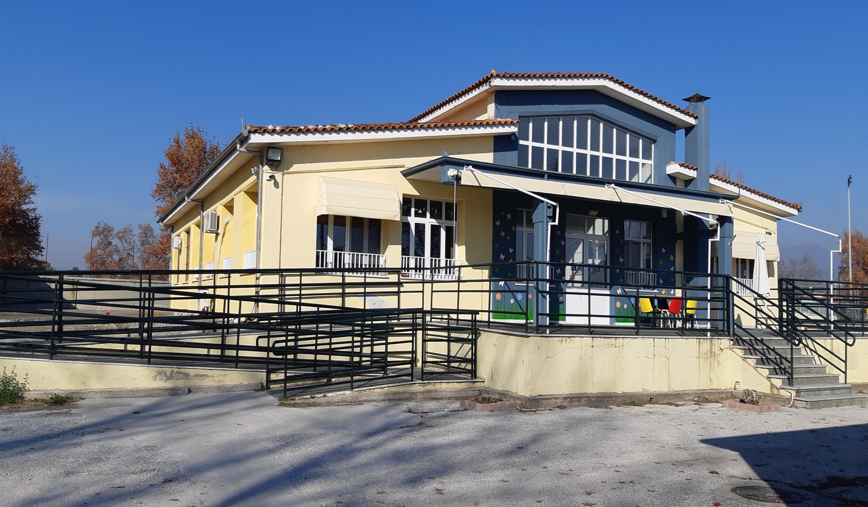
KDAP AMEA KEDIS HAS BEEN IN OPERATION FOR 20 YEARS AND IS HOUSED IN THE SPORTS PARK OF OMONIA.

Slide 3
It is a Creative Center for people with disabilities, under the act : Promotion and Support of children for their integration in pre-school education as well as for the access of children, adolescent and people with disabilities to KDAP.
This operation is co-financed by the European Social Fund (ESF) within the framework of the National Strategic Reference Framework (NSRF), for the programming period 2021 – 2027, and the Hellenic Society for Local Development & Self-Government (E.E.T.A.A) acts as the beneficiary of the operation.
The Center offers leisure activities and therapies to adults with severe disabilities from 19 to 67 years old. The number of served people is 33

Slide 4
Aims of the Creative Center for People with disabilities (K.D.A.P - A.M.E.A) are:
The creative occupation of adults with disabilities.
Social integration of adults with disabilities.
The support of families in order to face social exclusion and to avoid institutional care.
To improve the quality of life of adults with disabilities and of their families.
In order to achieve its goals KDAP AMEA offers the following services:

Slide 5
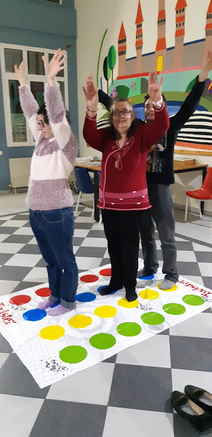
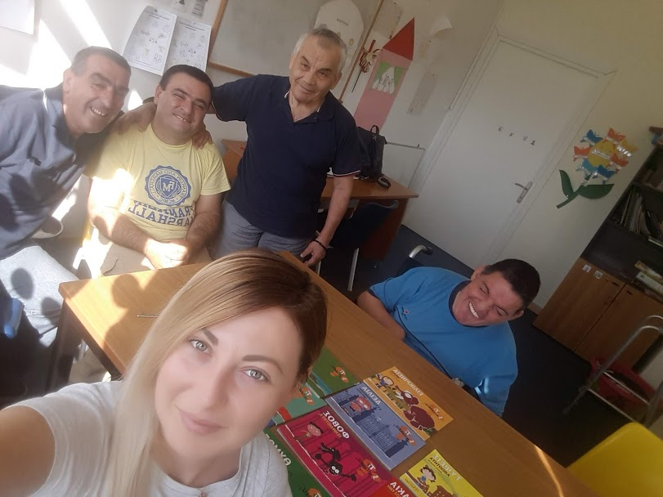
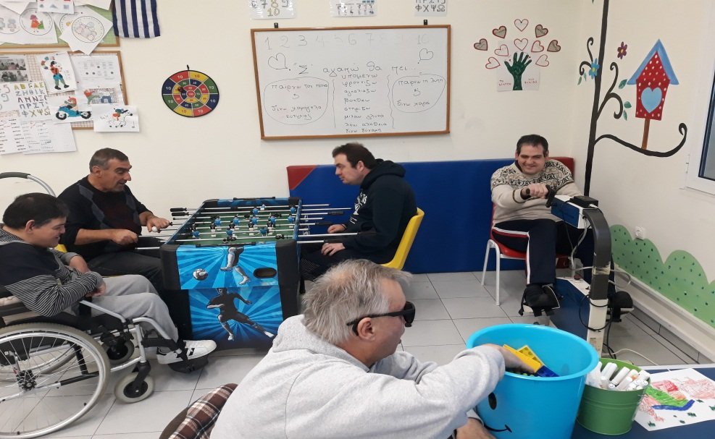
Sεcure occupation and leisure activities

Slide 6
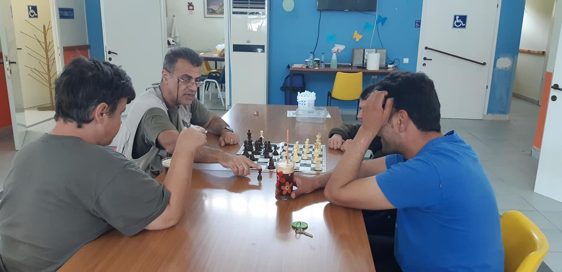
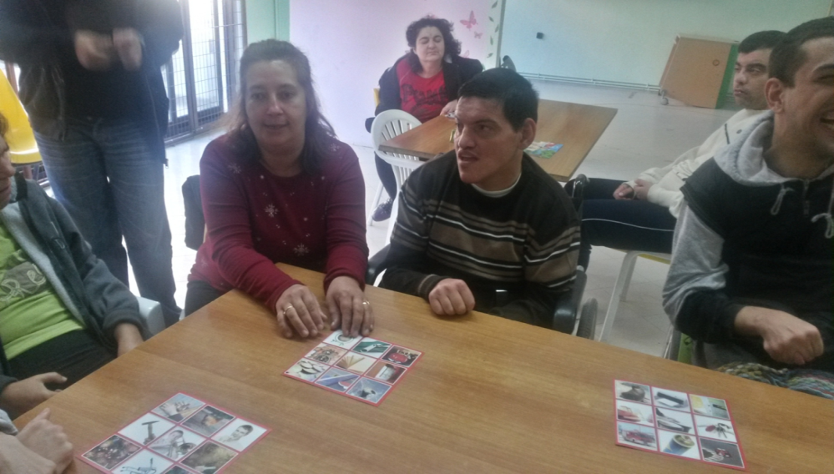
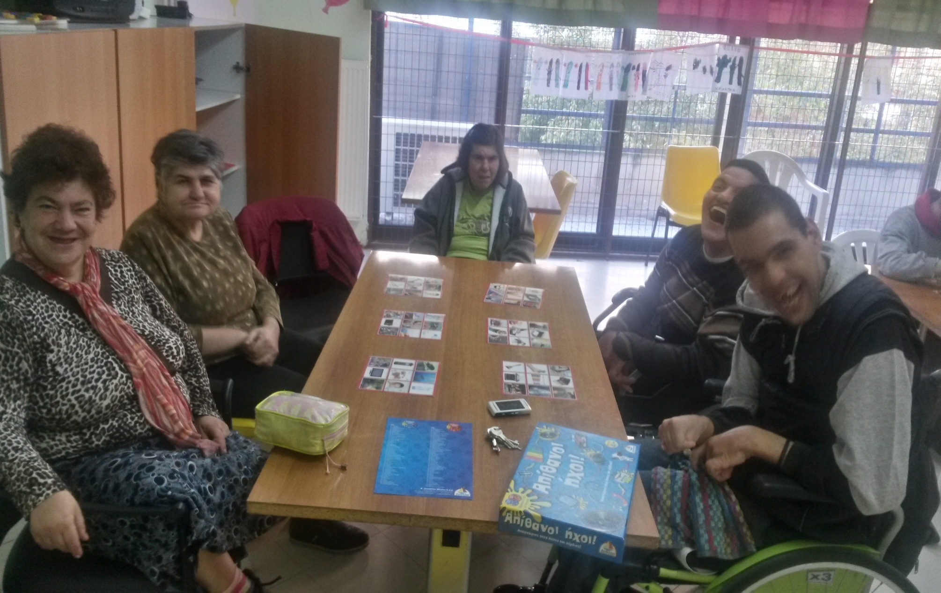

Slide 7
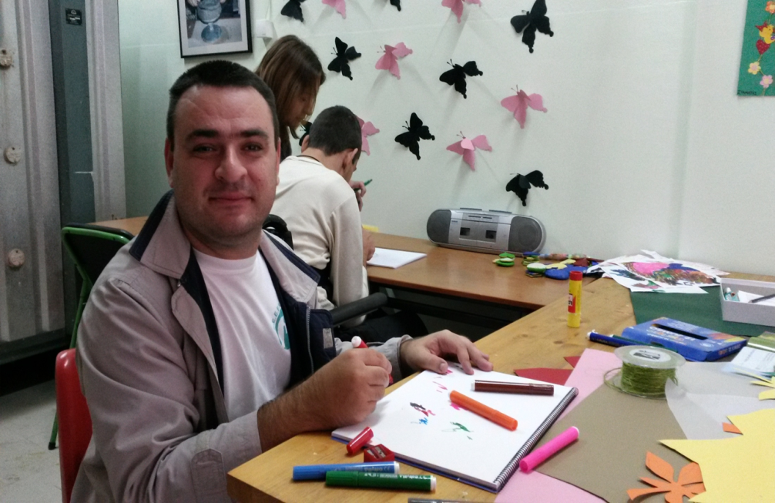
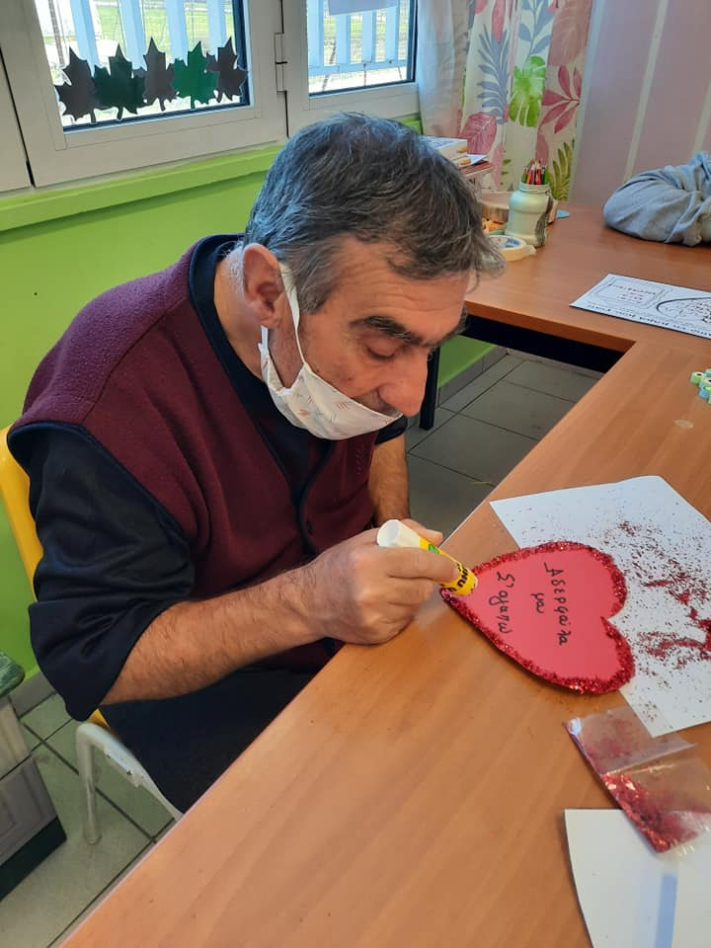
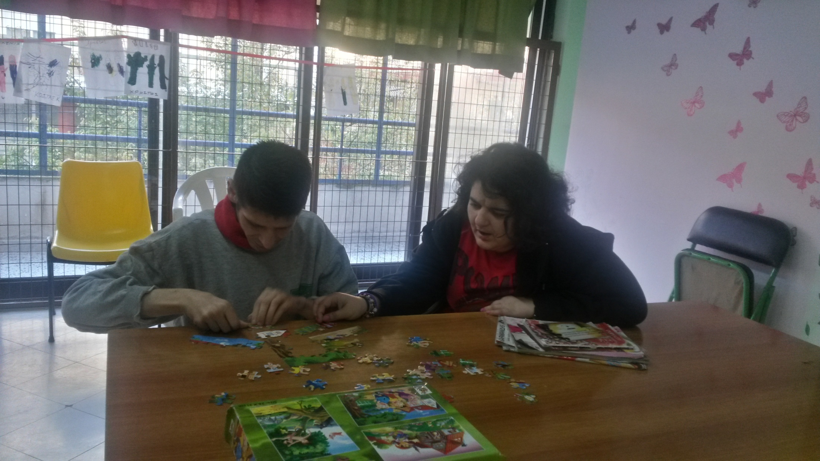

Slide 8
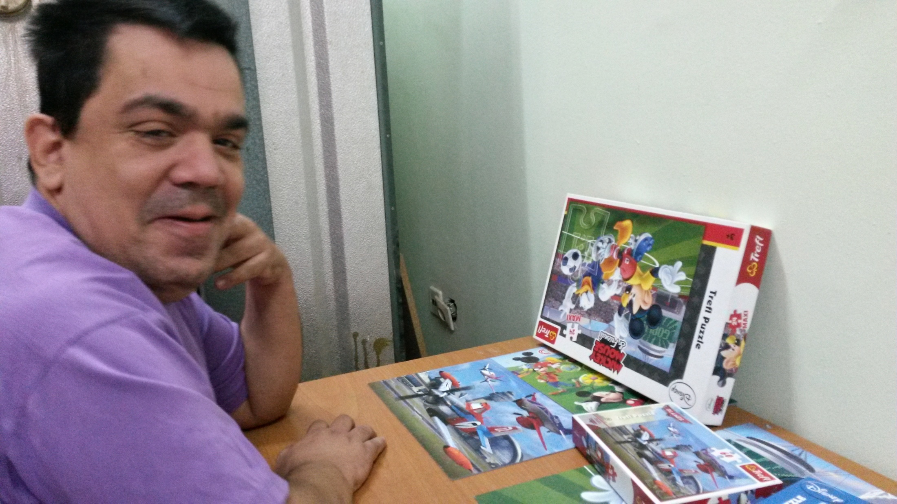
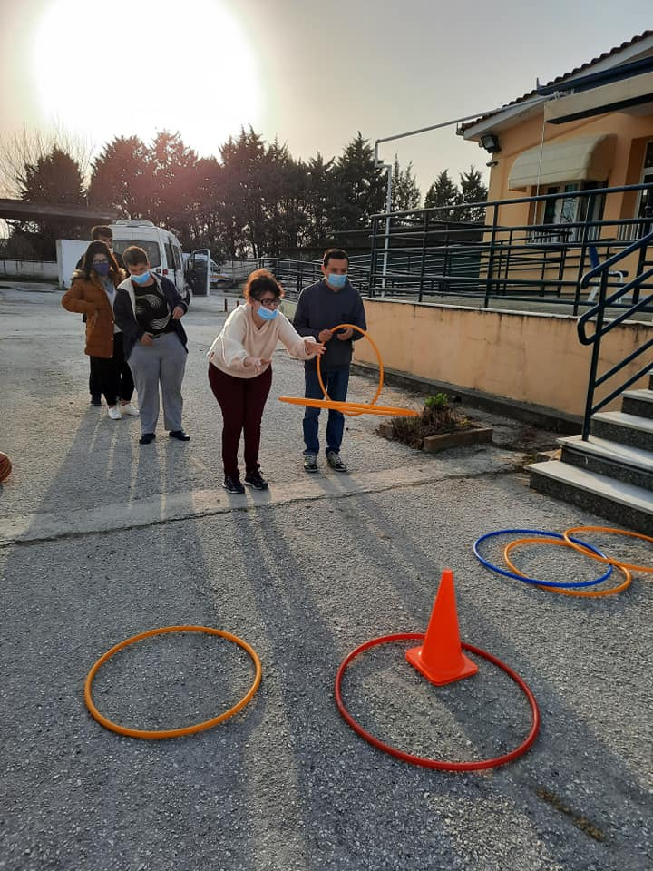
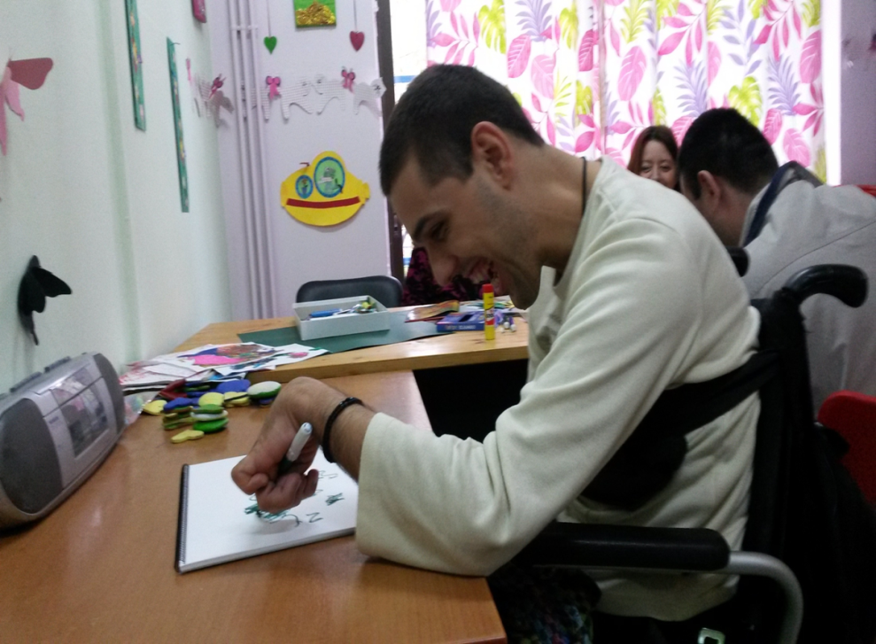

Slide 9
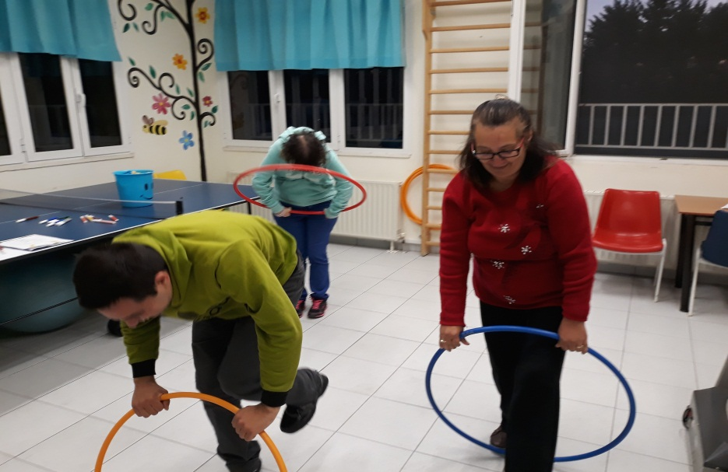
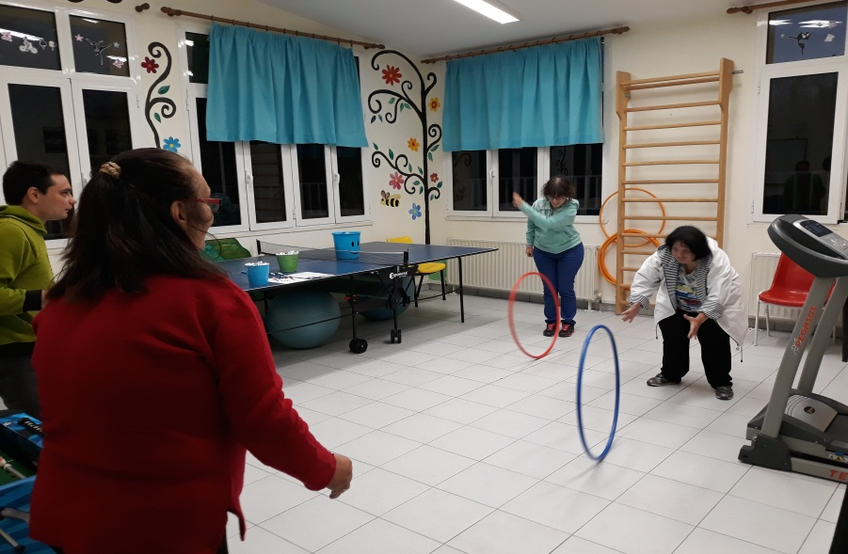
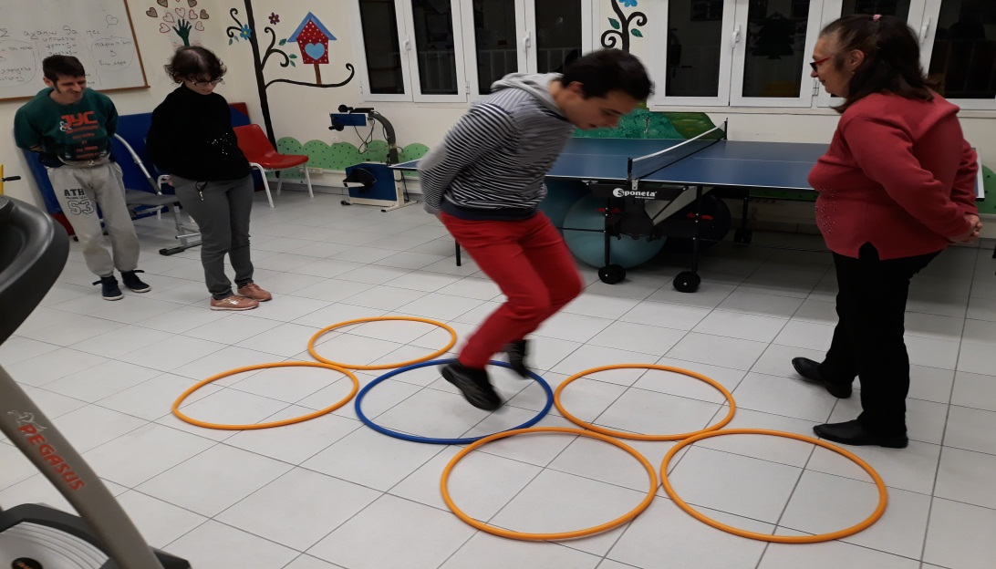
Programms regarding creativity, entertainment sports and prysical education

Slide 10
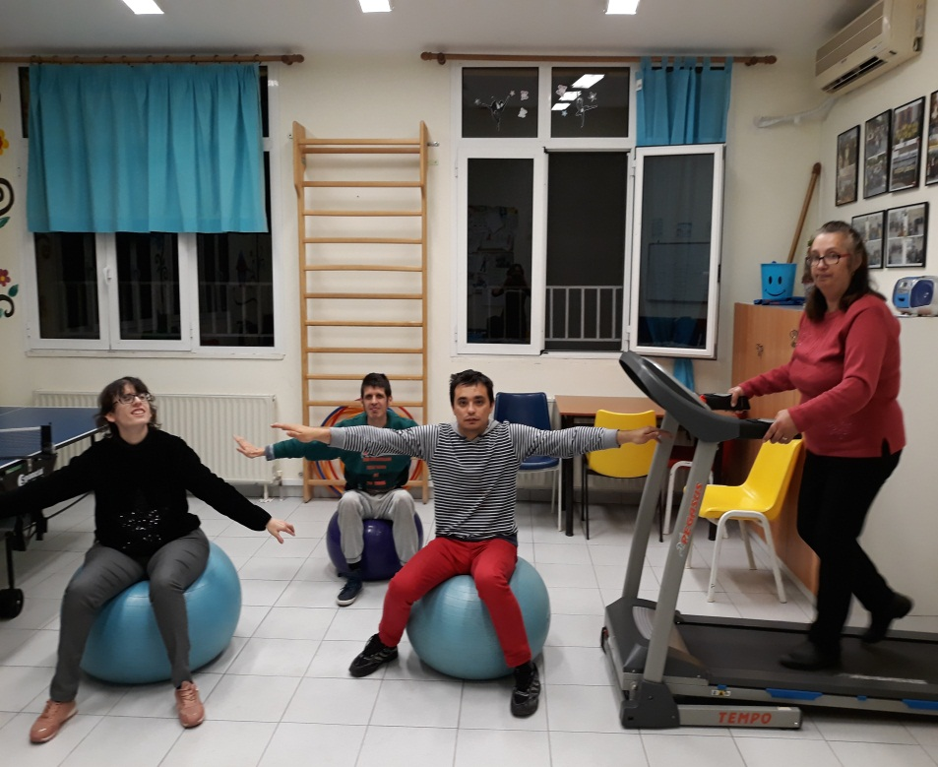
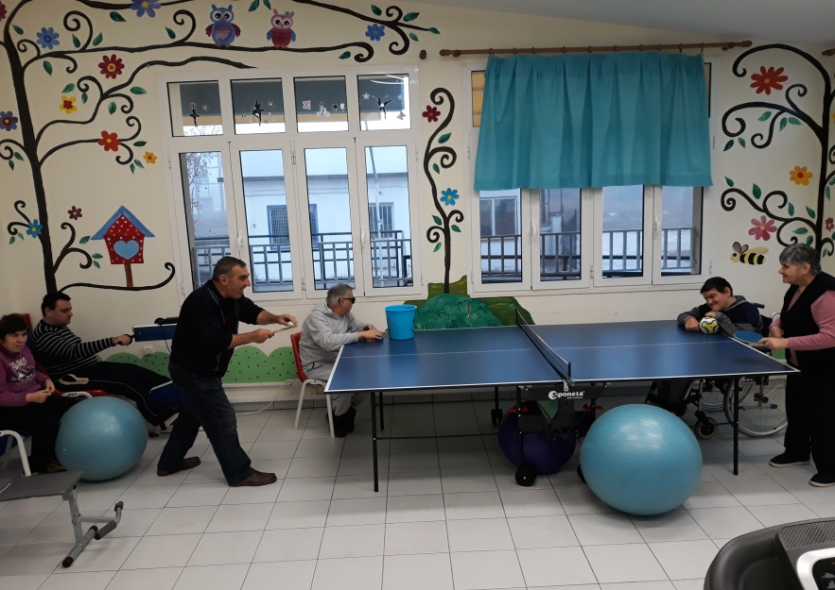
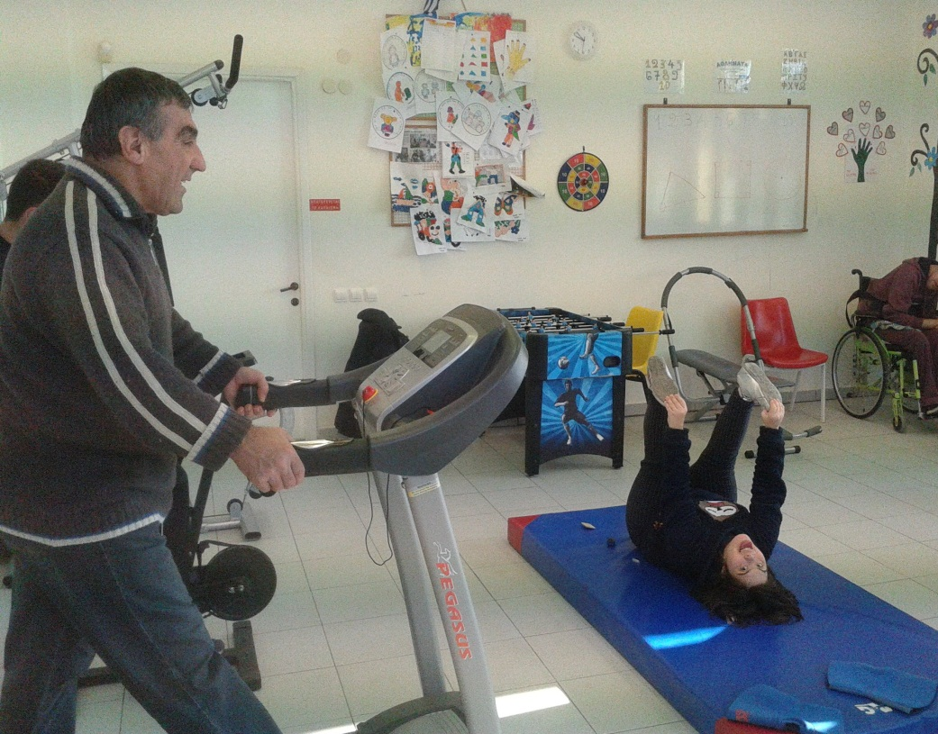
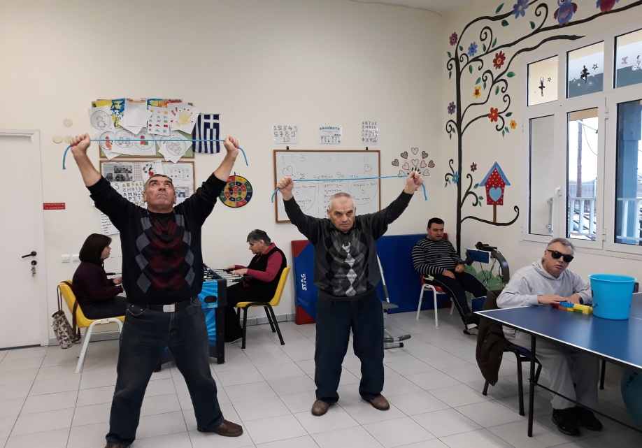

Slide 11
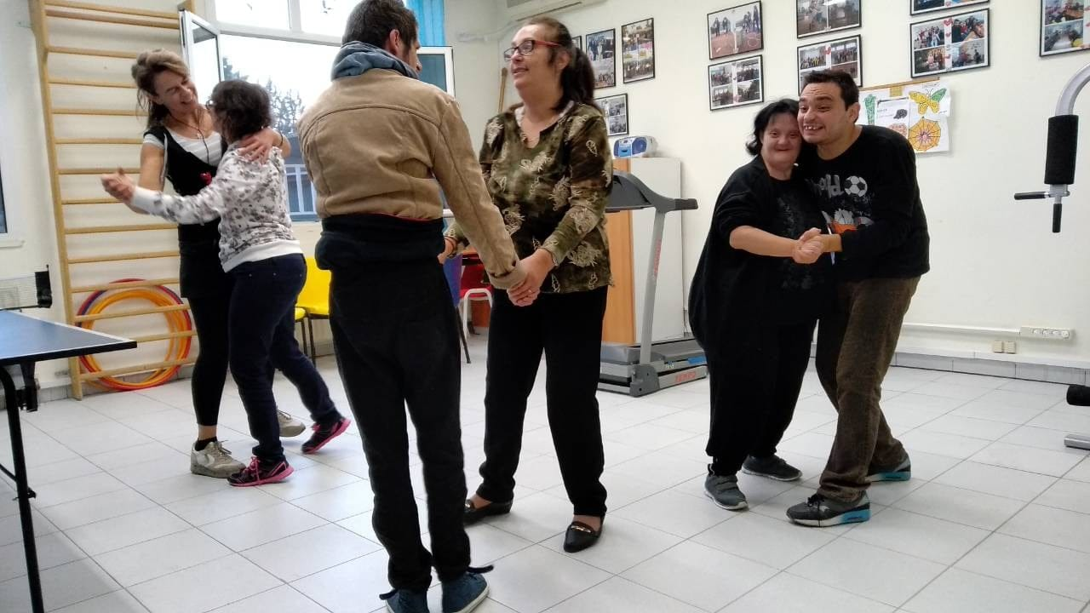
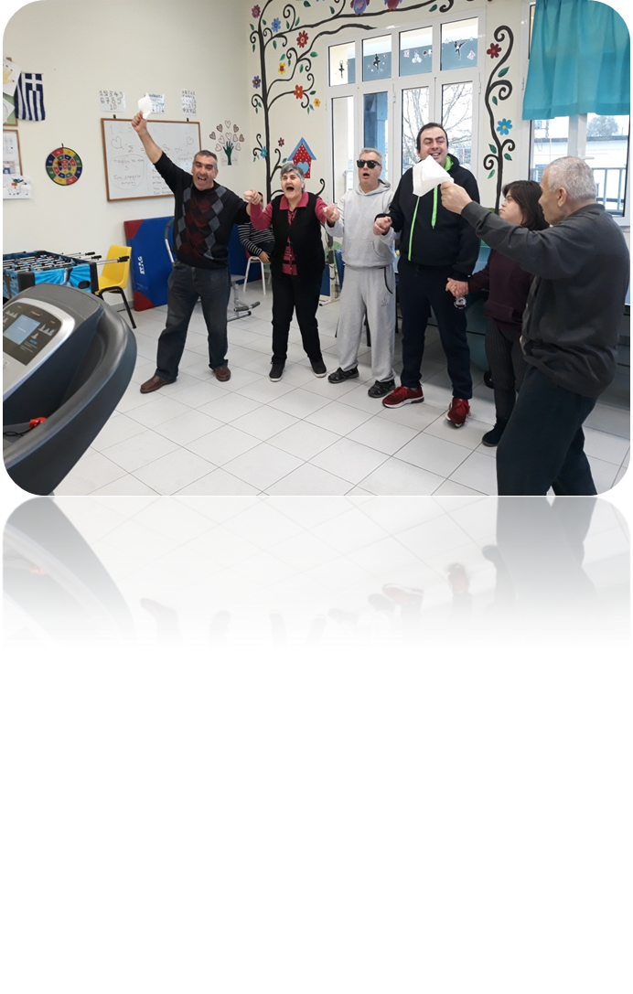
DANCE

Slide 12
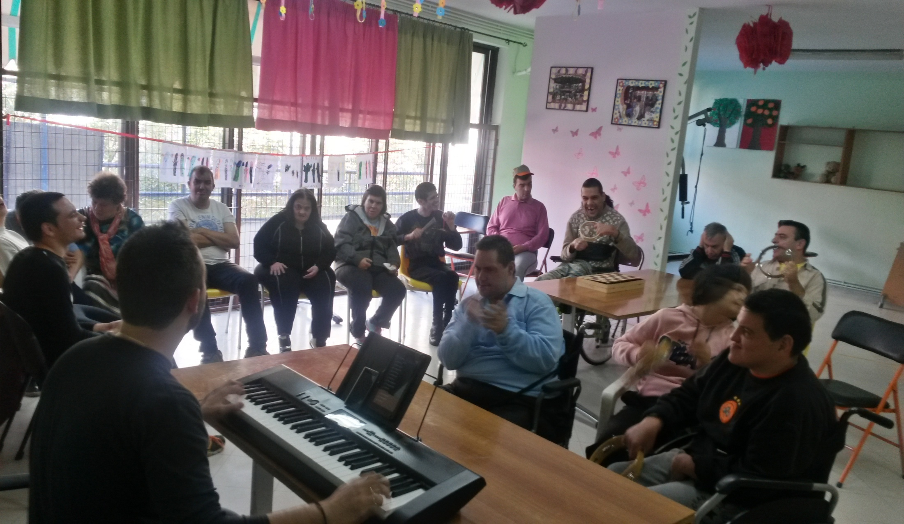
MUSIC

Slide 13
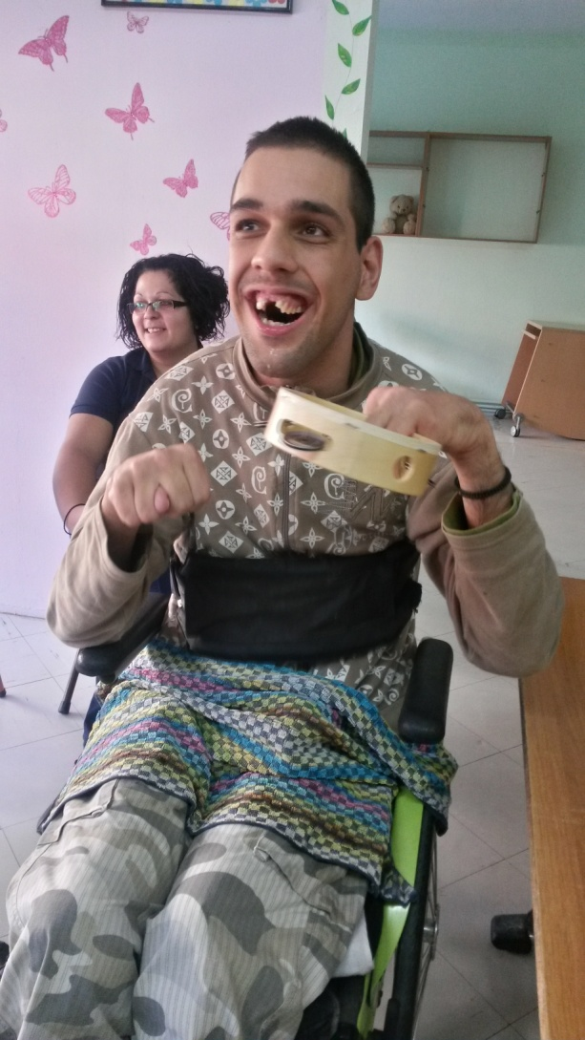
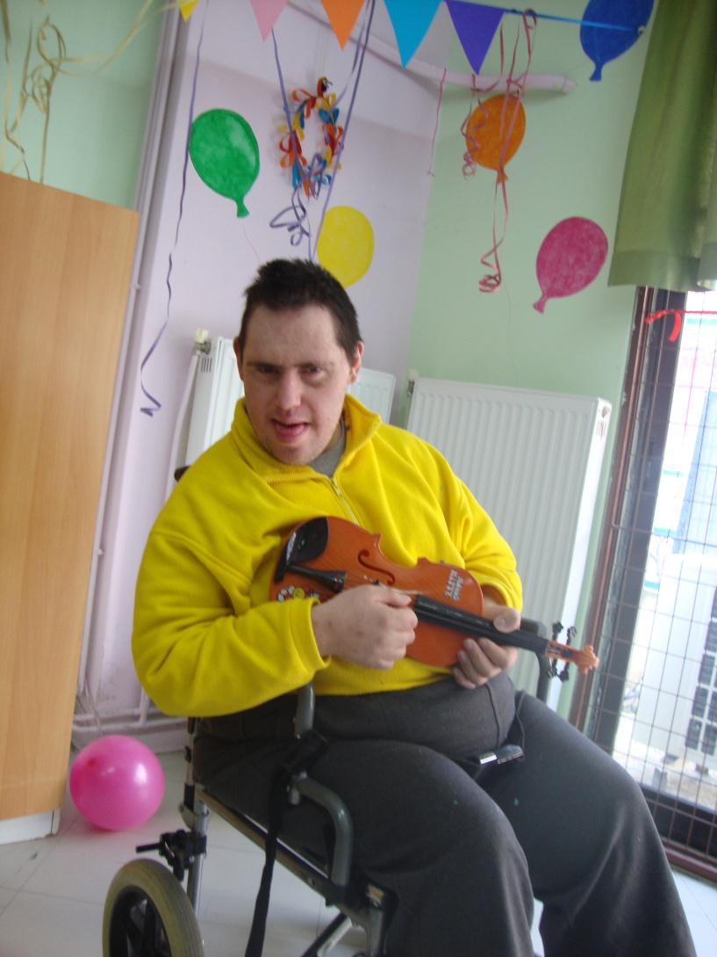
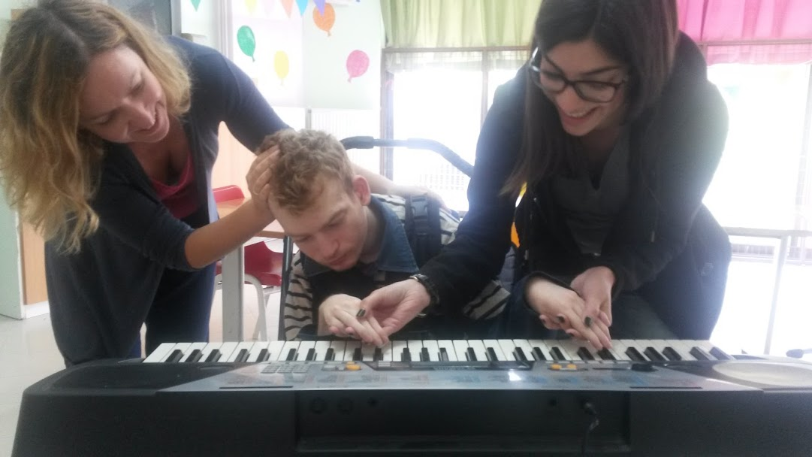

Slide 14
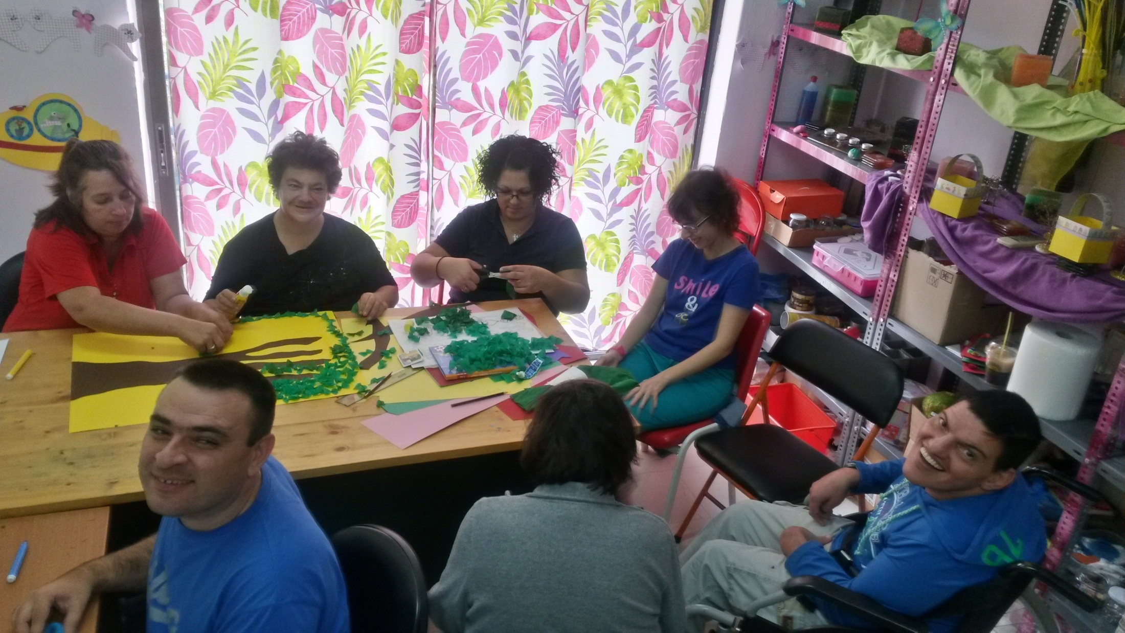
DECORATION

Slide 15
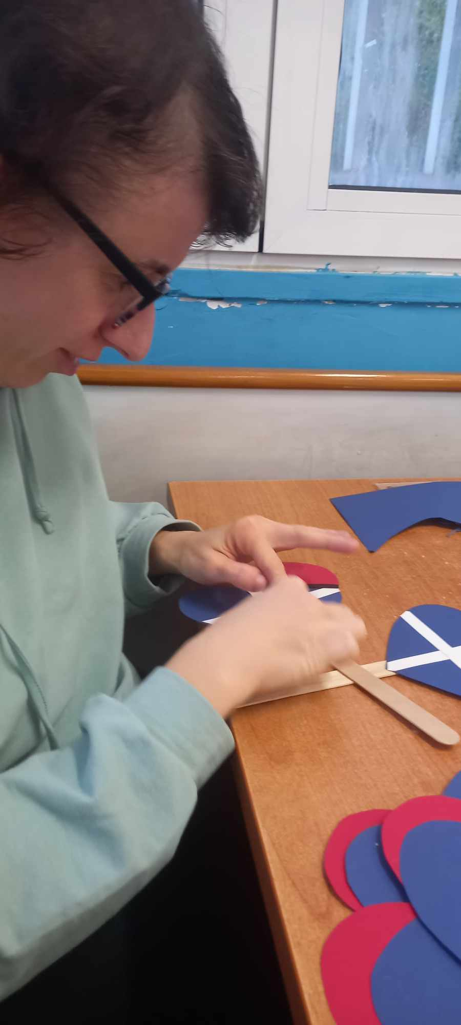
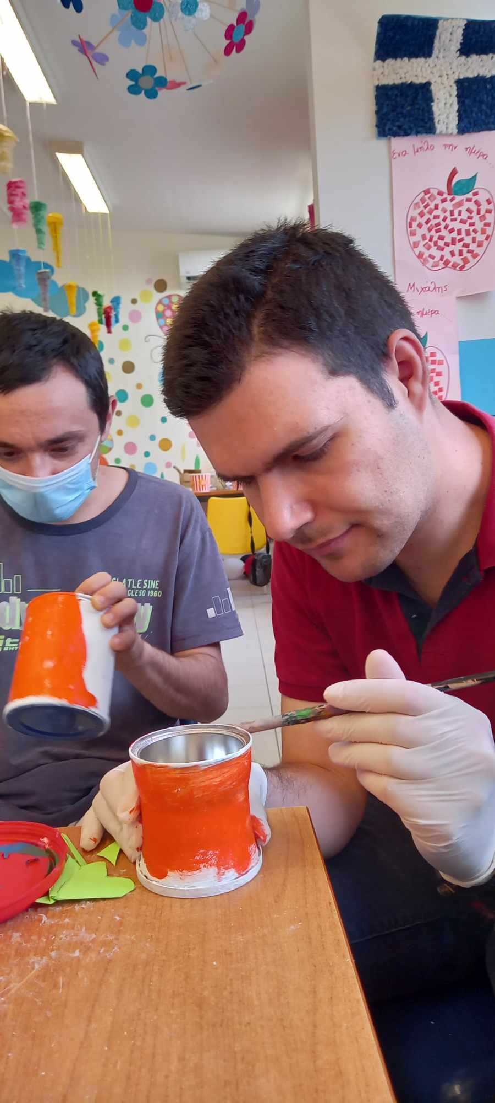
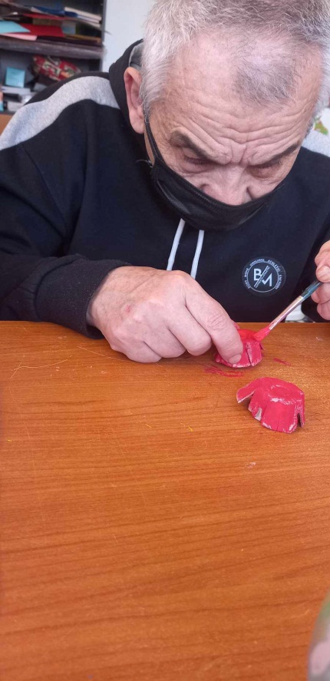
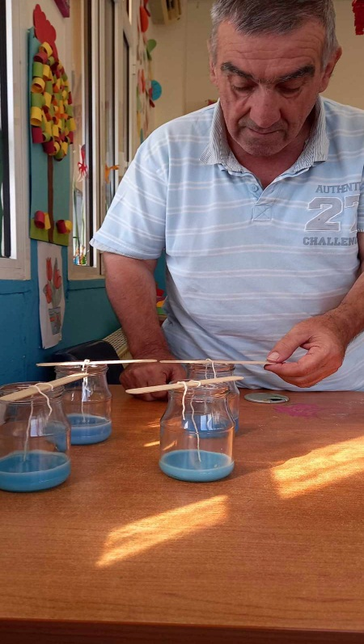
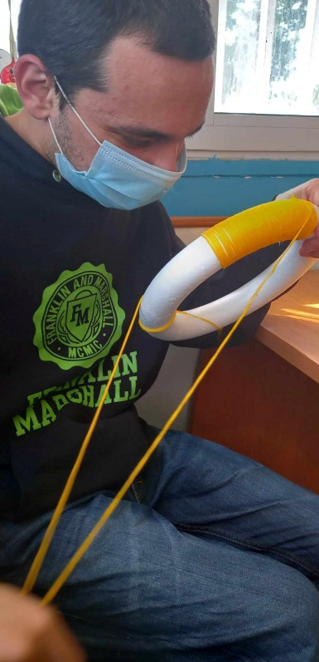
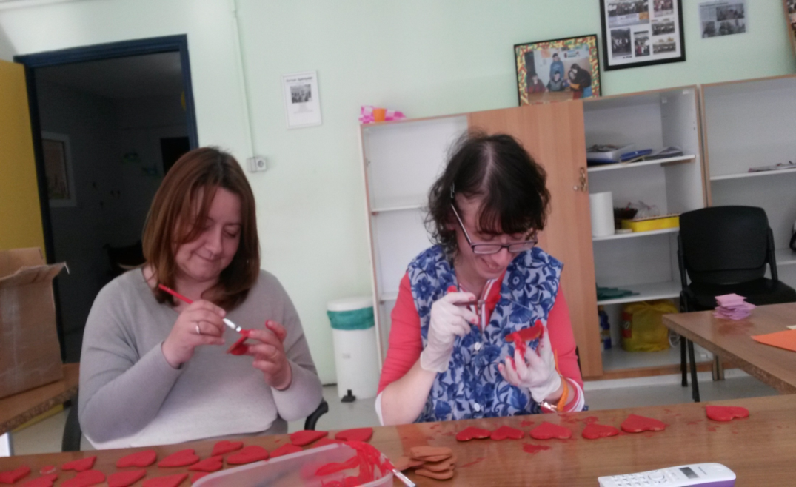
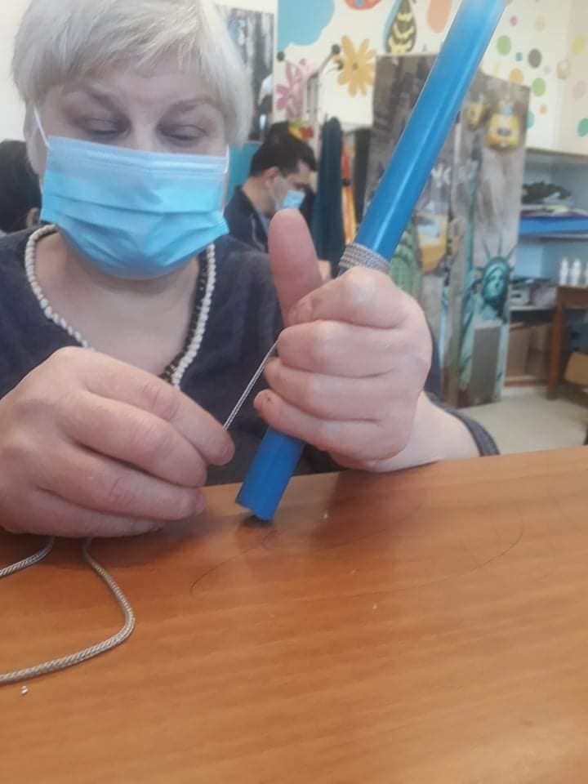

Slide 16
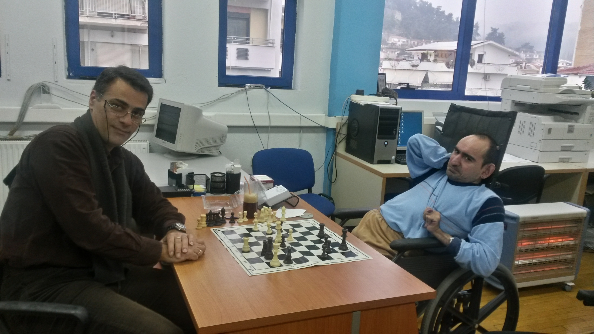
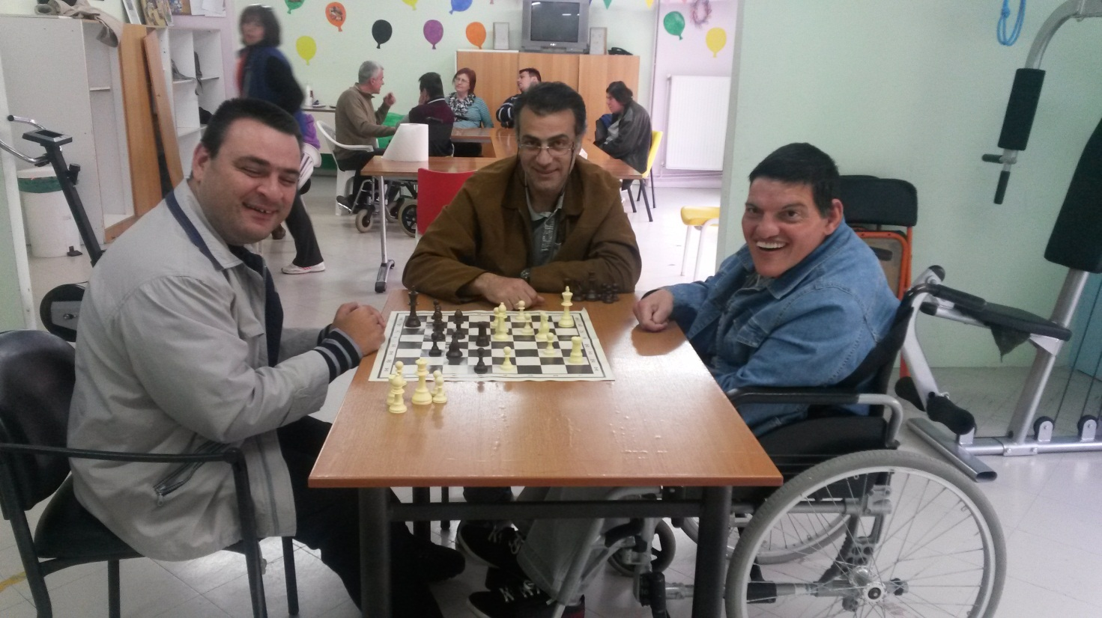
CHESS

Slide 17
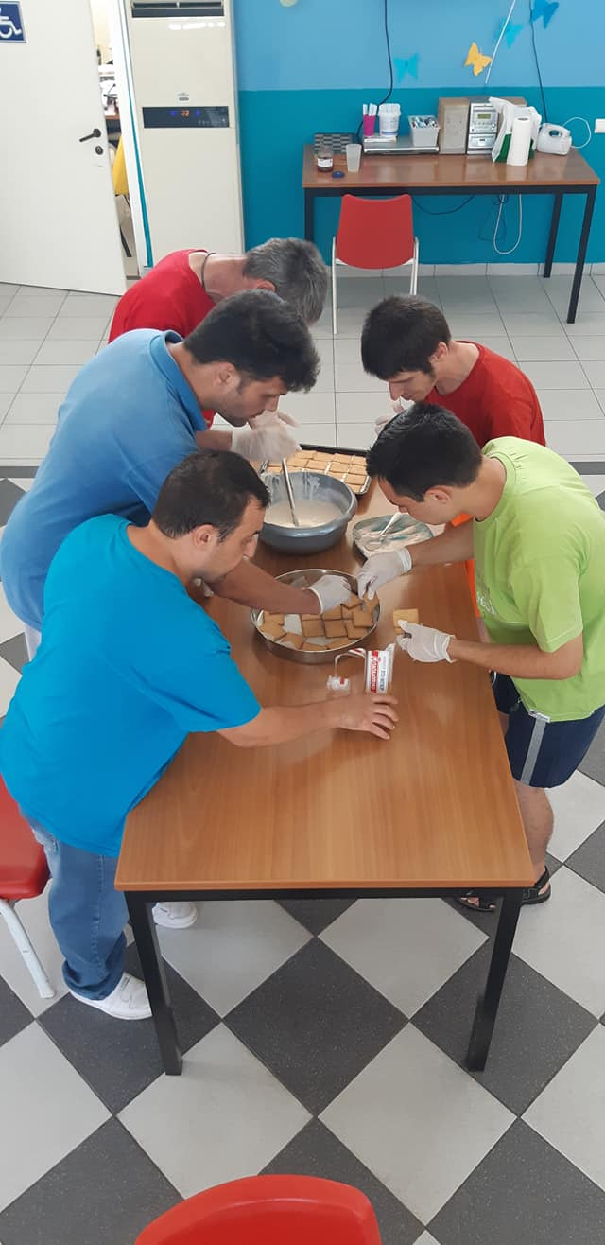
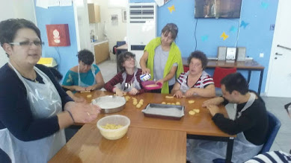
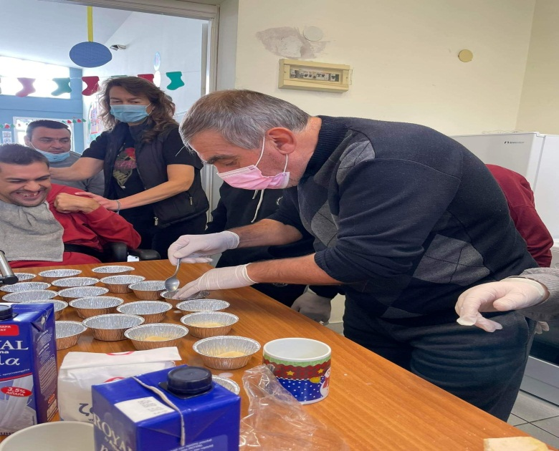
COOKING

Slide 18
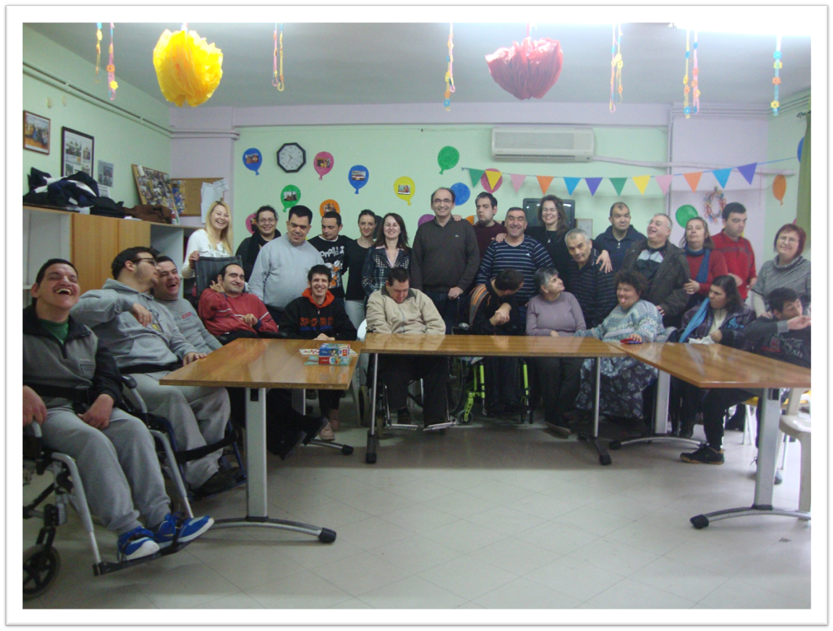
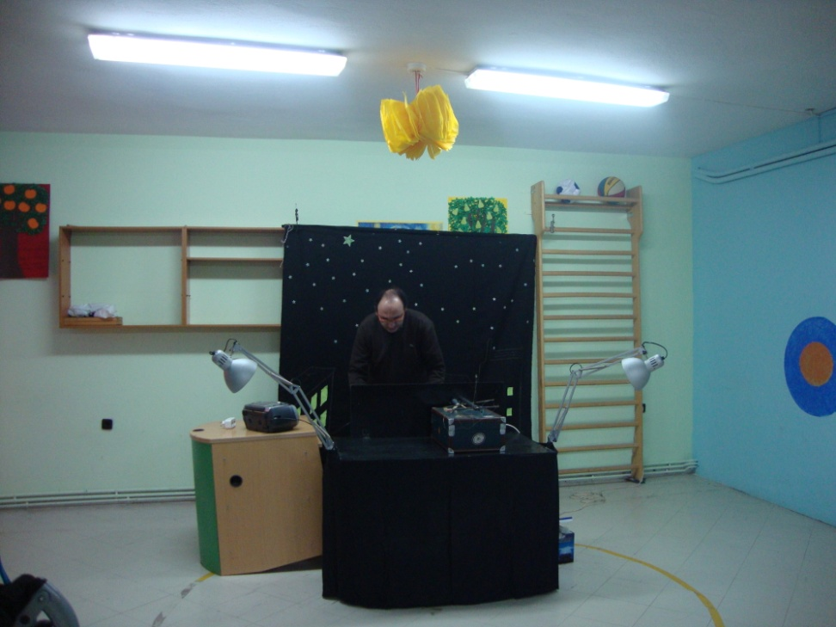
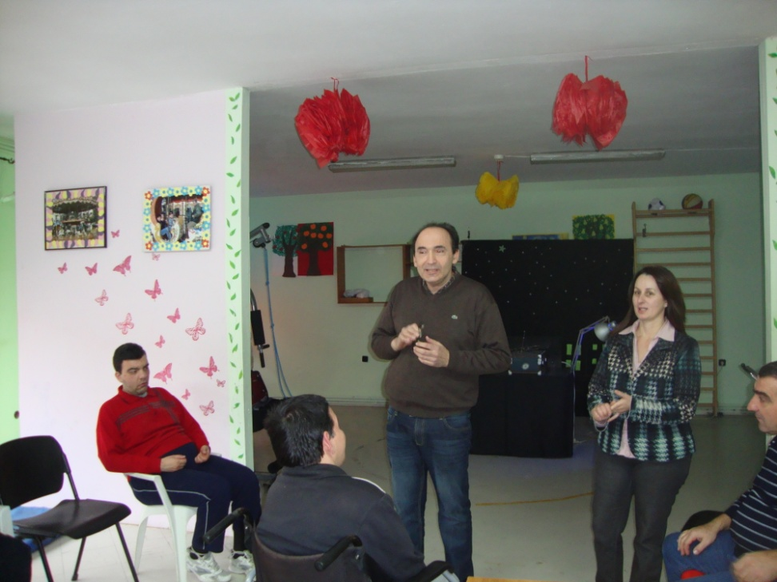
ΚΟΥΚΛΟΘΕΑΤΡΟ
PUPPETRY

Slide 19
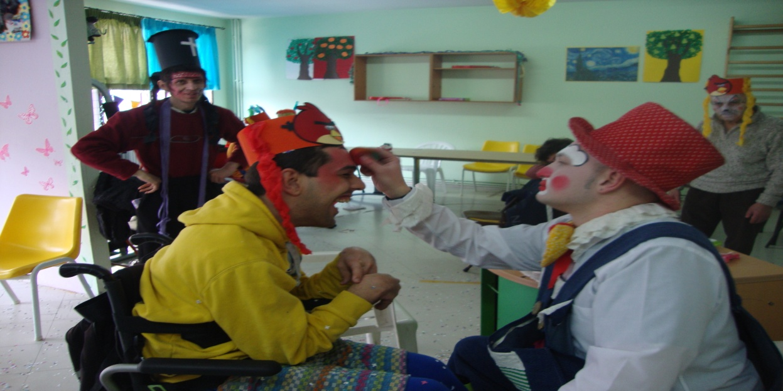
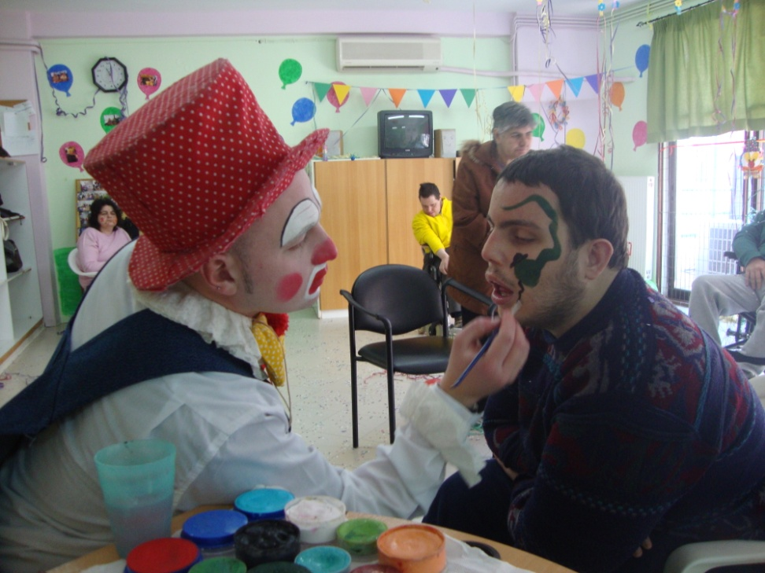
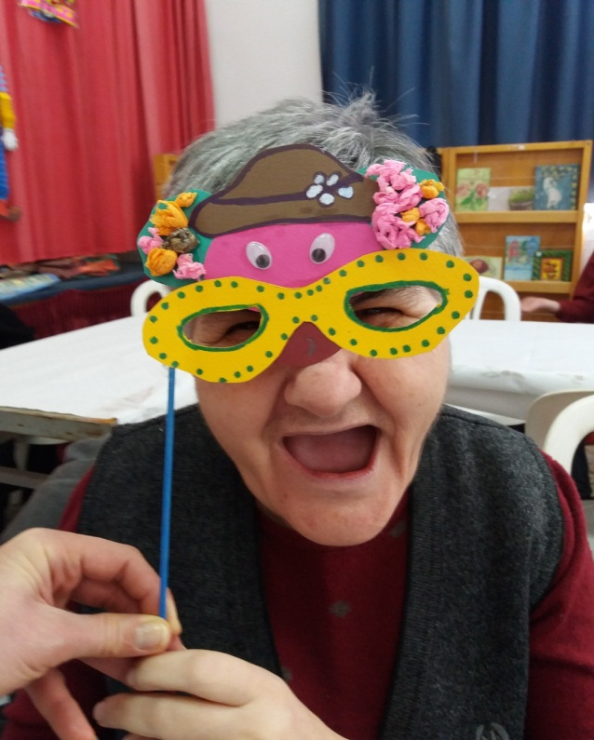
CARNIVAL

Slide 20
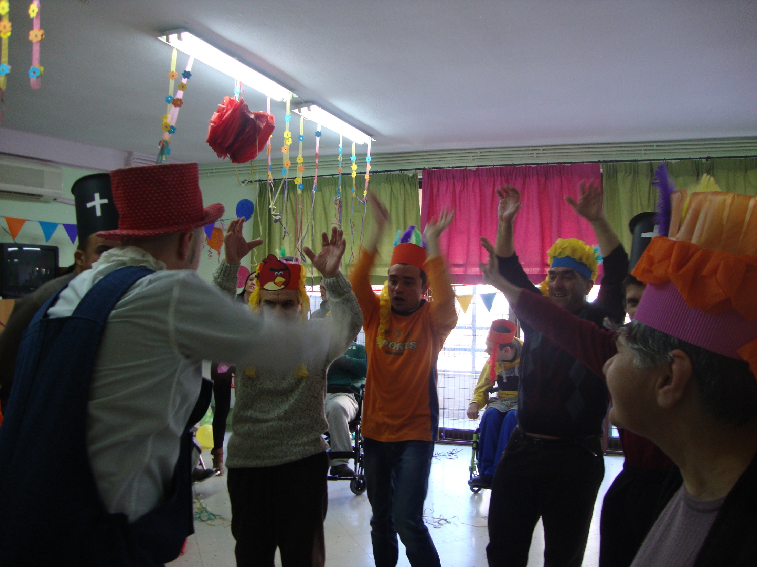
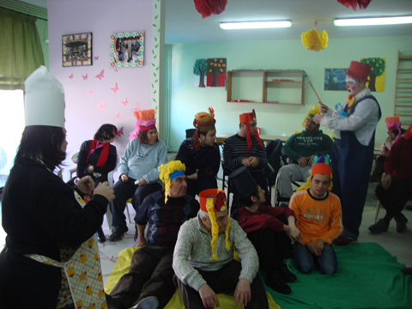
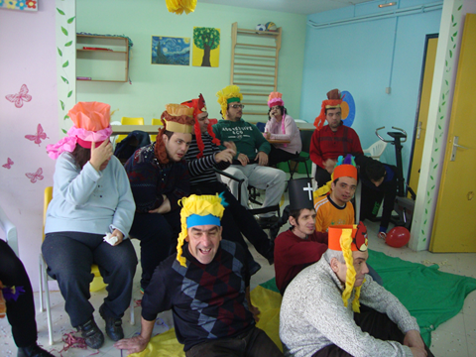

Slide 21
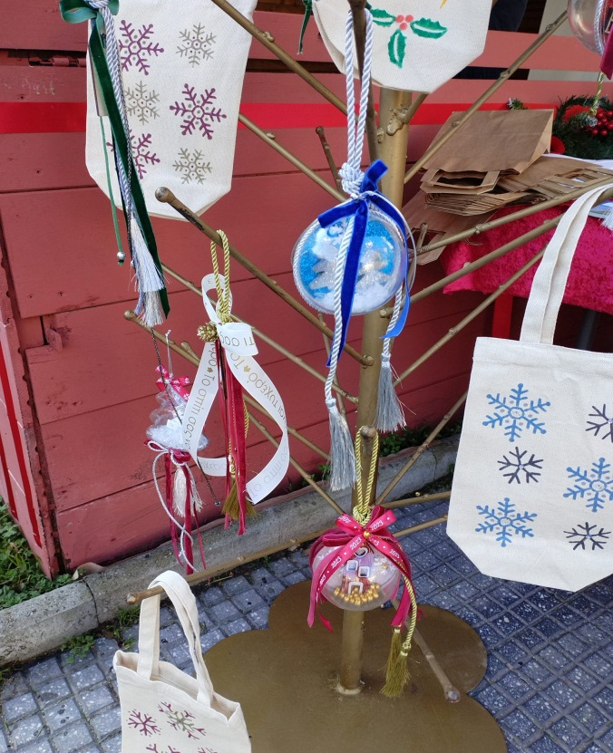
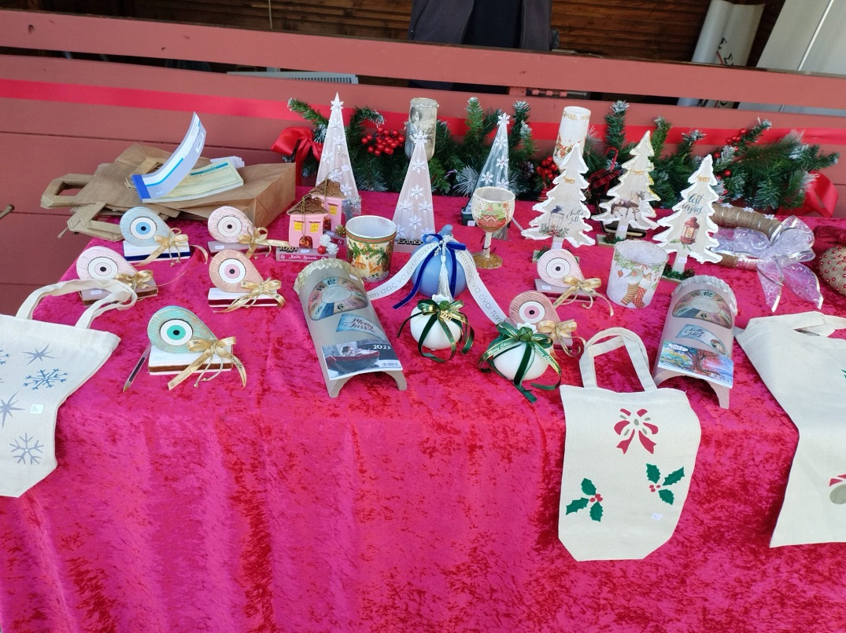

BAZAAR

Slide 22




Slide 23






Slide 24




BIRTHDAY PARTIES

Slide 25
Also,
KDAP AMEA offers individual education on issues self-treatment, supporting families, informing and referring them to relevant services in order to meet the specialized needs of their children.
Each Creative Center for people with disabilities employs specialized staff such as :
Social Worker
Physiotherapist
Social Carers
Technical Trainers
Physical Trainer
Auxiliary staff
Driver

Slide 26
Also,
KDAP AMEA offers individual education on issues self-treatment, supporting families, informing and referring them to relevant services in order to meet the specialized needs of their children.
Each Creative Center for people with disabilities employs specialized staff such as :
Social Worker
Physiotherapist
Social Carers
Technical Trainers
Physical Trainer
Auxiliary staff
Driver

Slide 27
In addition to the departments that operate in the KDAP AMEA area, we participate in various actions inside and outside the Municipality

Slide 28

PARTICIPATION OF KDAP AMEA IN THE ACTIONS OF THE "BRIGHT DAYS»

Slide 29




Slide 30




Slide 31




Slide 32

THEATRICAL PERFORMANCE

Slide 33




Slide 34



Slide 35

REPRESENTATION OF THE GRAPE HARVEST AT THE 1ST PANHELLENIC DANCE MEETING AT KATO KAMILA

Slide 36



Slide 37



MEDICAL EXAMINATION IN A MOBILE MEDICAL CENTER

Slide 38


VISIT TO KETHIS

Slide 39

SUMMER FESTIVAL OF KDAP KEDIS

Slide 40

Participant in the 2nd kdap amea festival in Thessaloniki

Slide 41




Slide 42


PARTICIPATION IN THE 3rd KDAP AMEA FESTIVAL IN THESSALONIKI

Slide 43



VISITS AND ACTS WITHIN THE CONTEXT OF INCLUSION

Slide 44




Slide 45

ECO FESTIVAL

Slide 46



STATE OF WISHES

Slide 47




Slide 48

PARTICIPATION IN THE ROUND OF SERRES

Slide 49



INFORMATION AND SENSITIZATION
FOR DISABILITY

Slide 50





EXCURSIONS

Slide 51




Slide 52


Slide 53
THANKS
FOR
YOUR ATTENTION

