Slide 1


Erasmus+ IMPROVING MUNICIPAL SERVICES IN THE FIELD OF CULTURE, ART, SPORTS FOR PEOPLE WITH DISABILITIES Meeting in Pärnu august 2023

Slide 2
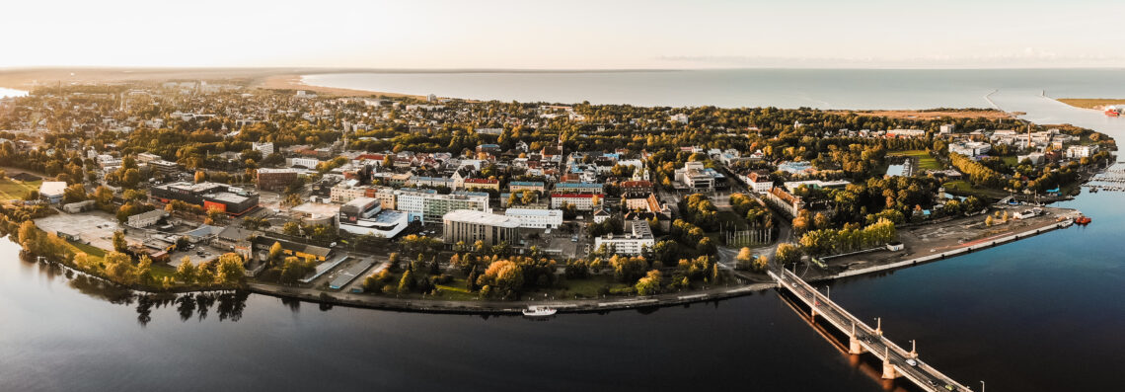
Pärnu
Pärnu introduction
https://www.youtube.com/watch?v=rneBYYIfJGk
Sport in Pärnu

Slide 3
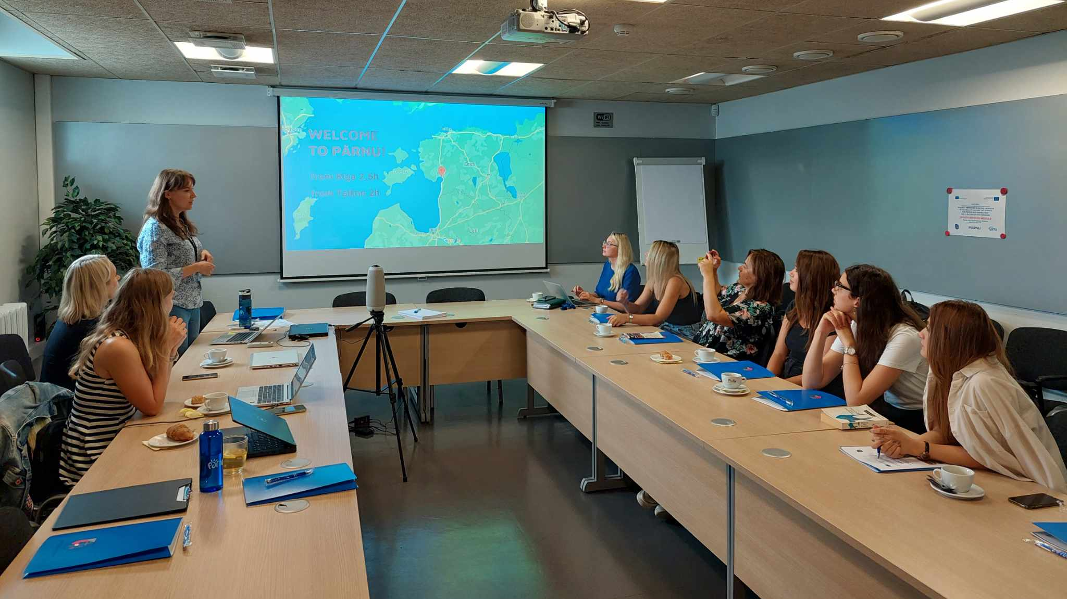
Start of the meeting

Slide 4
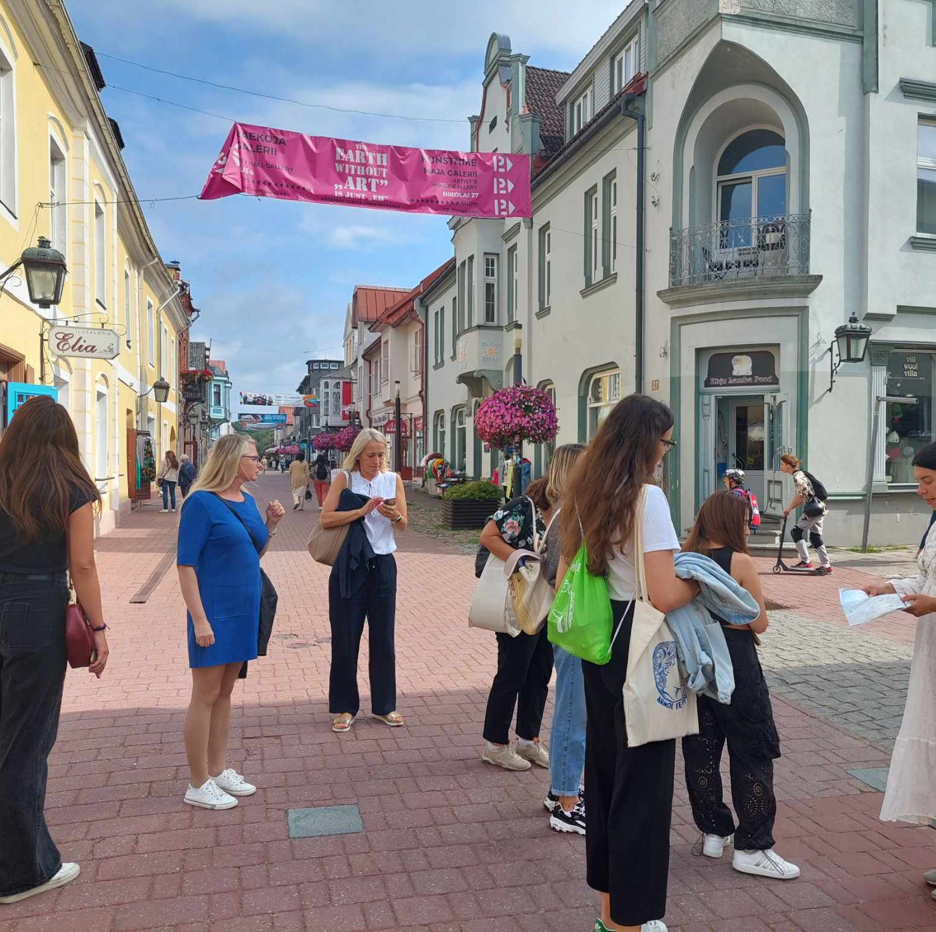
Start of the Pärnu city tour

Slide 5
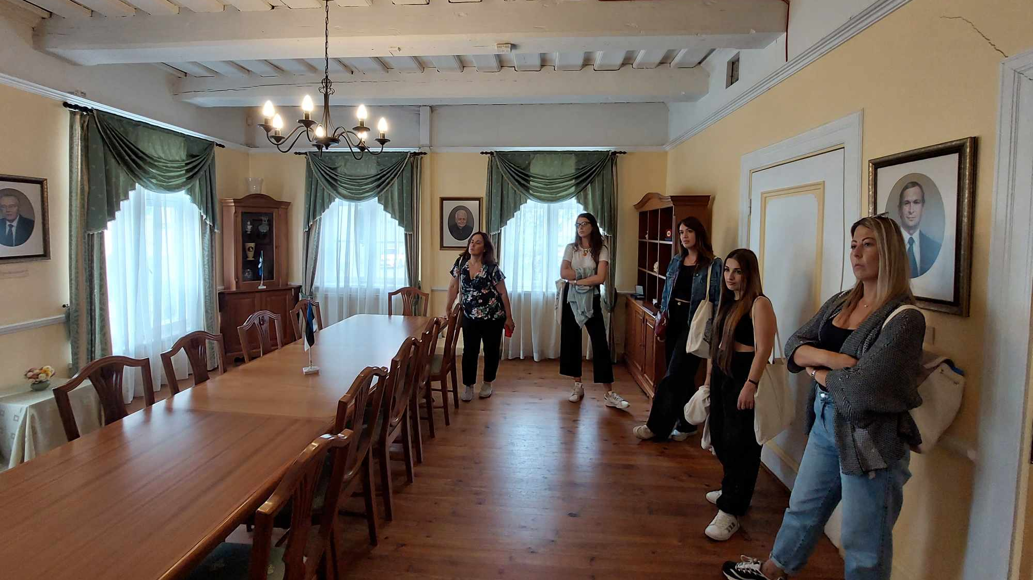

Slide 6
Study visit to Psychiatry Day Center of Pärnu Hospital
Financed by the state
Free of charge for clients
Different creative and sport activities
On the day we visited the center, some clients were participating in a sports day for people with special needs

Slide 7
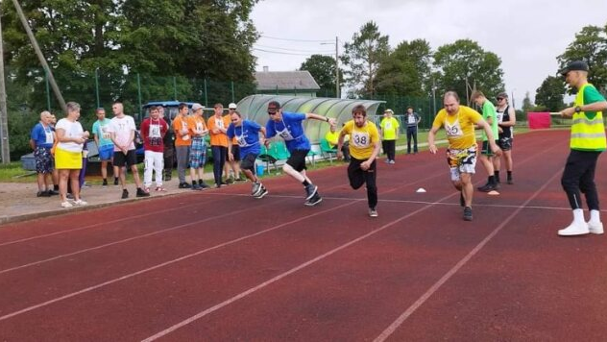
Sports day for people with special needs

Slide 8
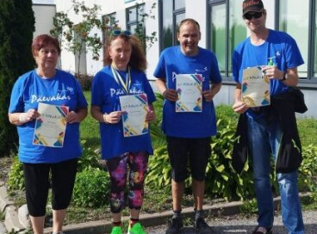
Victorious Day Center clients after the sports day

Slide 9
Study visit to Children and Youth Mental Health Support Center
The main service is psychological counseling and supportive therapies for children and adolescents of various ages, as well as for parents.
Residents of Pärnu County can turn to the center; the services are funded through Pärnu City and the Pärnu County Municipalities Union.
The services of the center are free of charge for residents of Pärnu County and Pärnu City.
No referral, disability confirmation, rehabilitation plan, or referral from another institution is required for seeking assistance.
However, Pärnu City child protection workers guide and collaborate with families in need of counseling, directing them to access the services
If the issue requires medical intervention, assistance can also be obtained from the psychiatric clinic (it is located nearby).

Slide 10
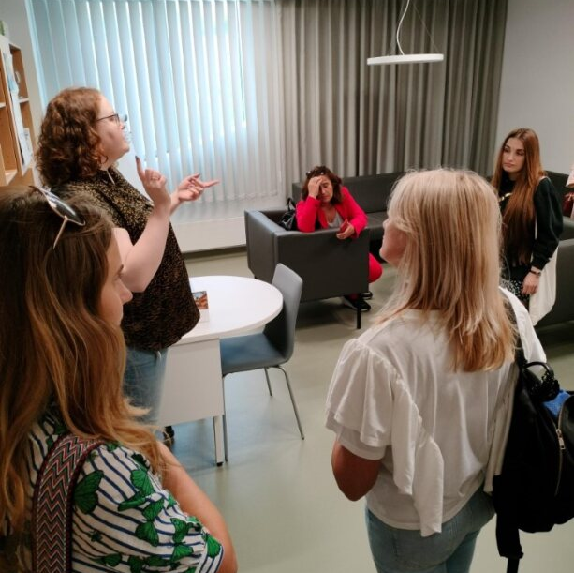
Partners from the ERASMUS+ project visited the Children and Youth's Mental Health Support Center and listened to the manager to give an overview about different services provided by the center.

Slide 11
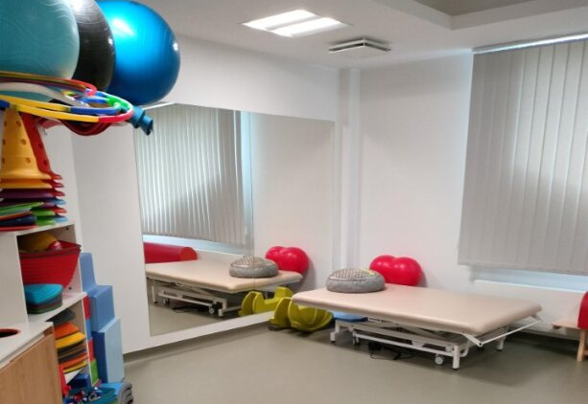
A Physical therapy room in the Children and Youth Mental Health Support Center

Slide 12
Study visit to Pärnu Päikese School for children with special needs (Pärnu Sun School)
Pärnu Päikese School is a municipal school in Pärnu City. The school is intended for children in Pärnu City, but in the presence of available school places, there is an opportunity to accept students from the county
Teaching is conducted based on the simplified national curriculum for basic school in coping or care education
The school also offers daycare services, known as full-day school. The service is fee-based, and if necessary, it is possible to submit applications to Pärnu City for support or services (such as support services, personal assistant services, etc.
Daycare is implemented daily throughout the day until 18:00. Daycare services are provided during all school holidays from 7:30 to 18:00

Slide 13
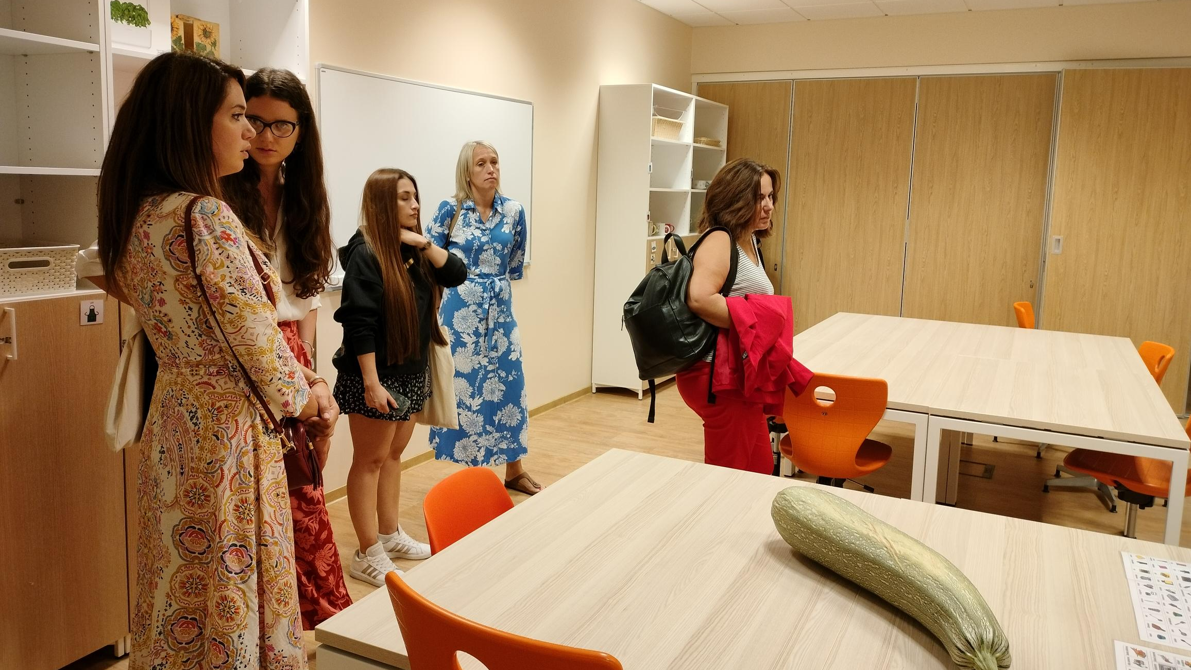
Partners from the ERASMUS+ project visiting the school

Slide 14
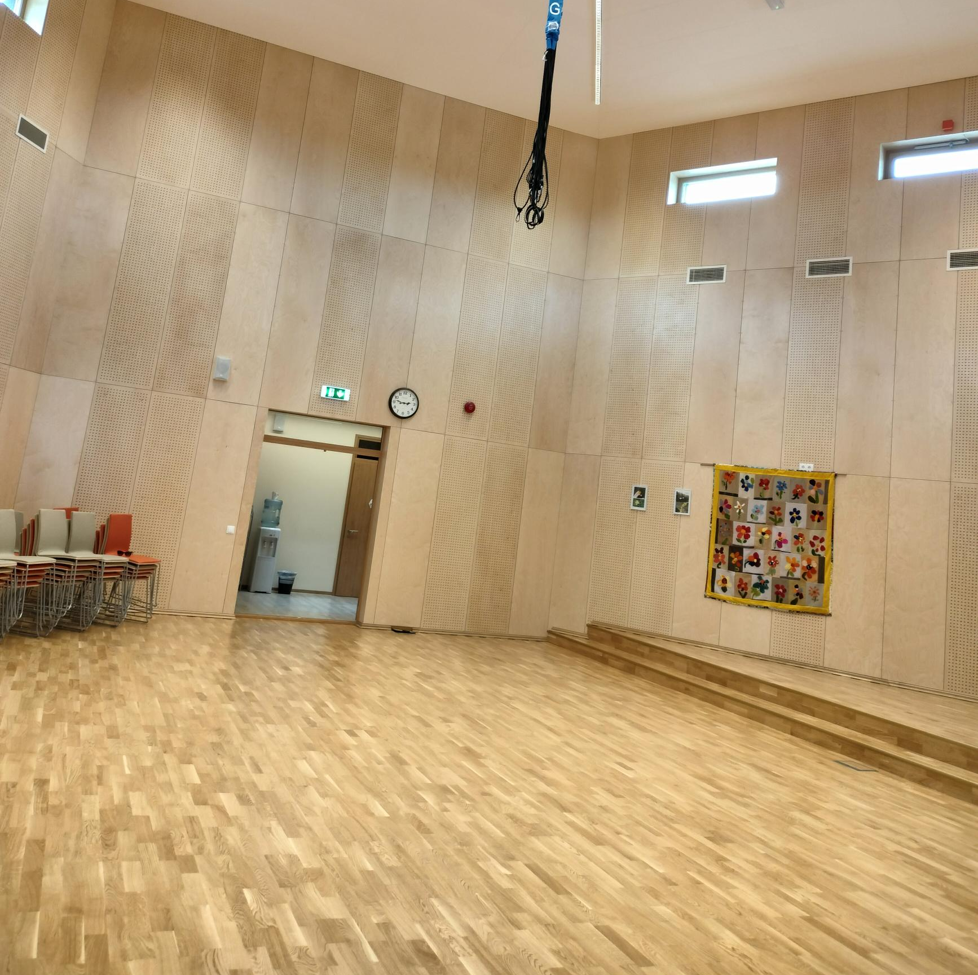
The Grossing
The Grossing system, or ceiling-mounted safety harness system, is a helpful tool in physiotherapy for students with mobility disabilities. Rehabilitation grossing is both a method of teaching movement activities and a training aimed at improving a person's mobility. The methodology and system of grossing have been developed by the former figure skater and figure skating coach.
Grossing is also a form of mood therapy. Good mood and well-being are certainly associated with the use of this device.

Slide 15
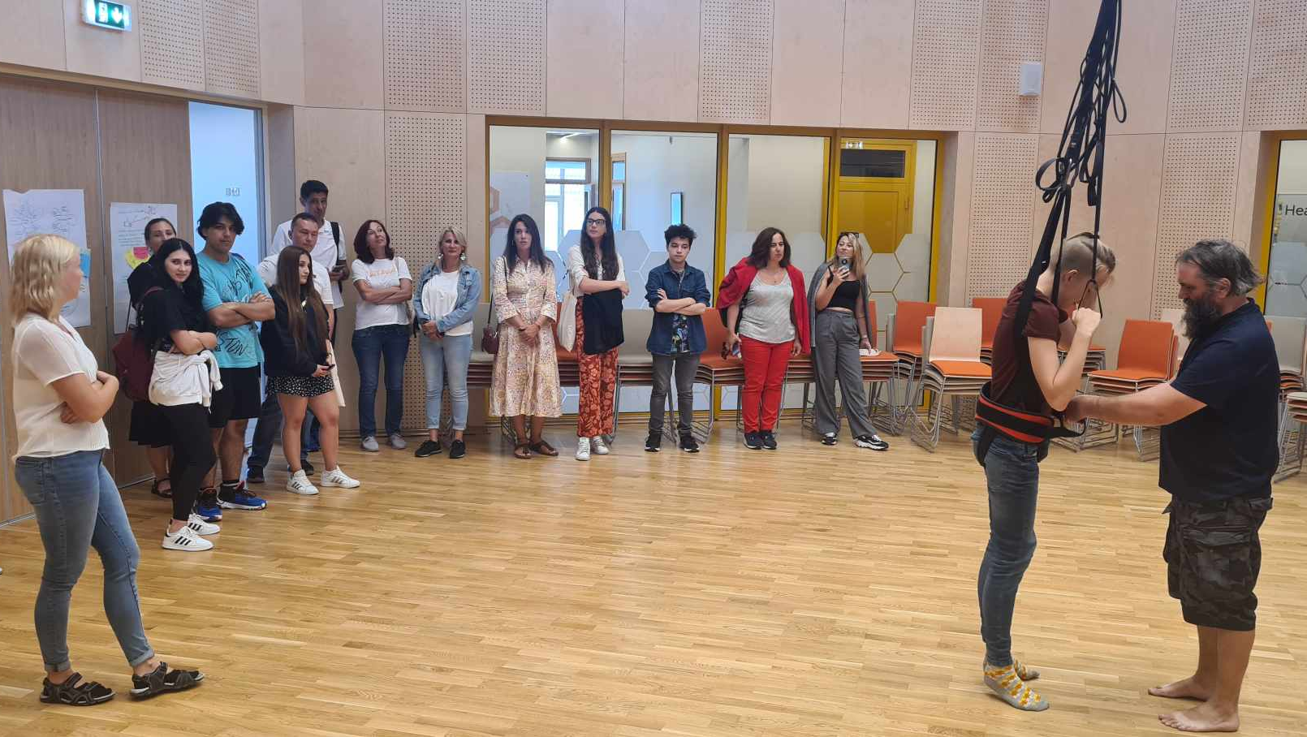
Student and teacher presenting the grossing system to ERASMUS+ partners

Slide 16
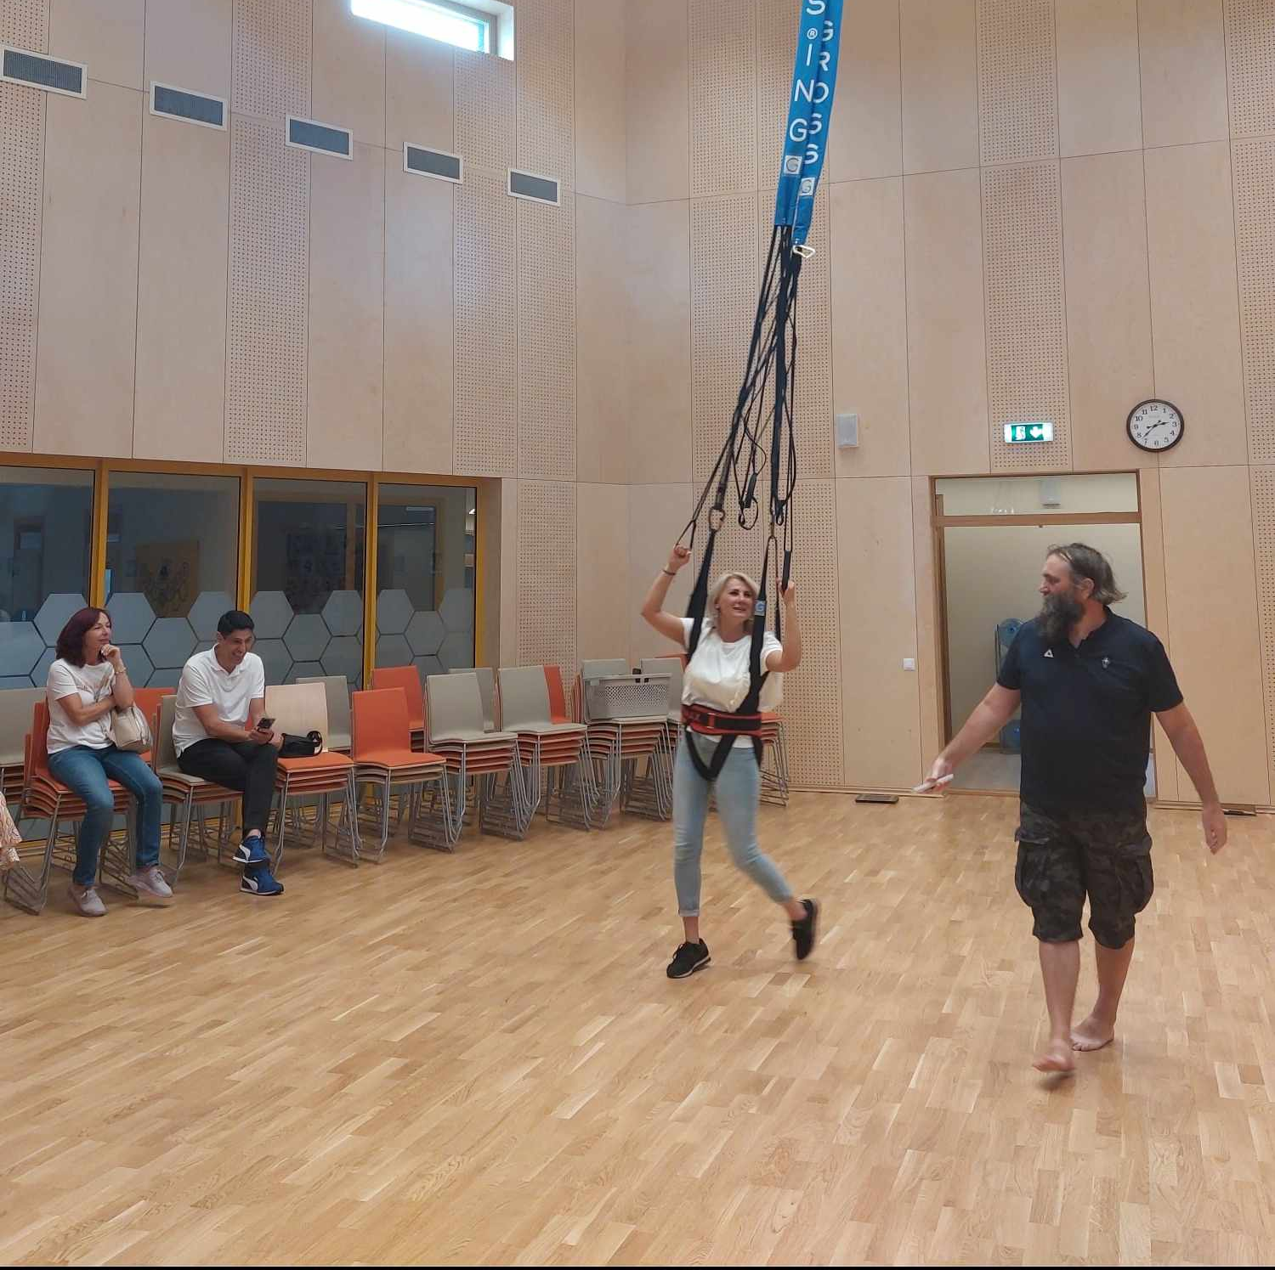
Testing the grossing system by representative of ERASMUS+ partner

Slide 17
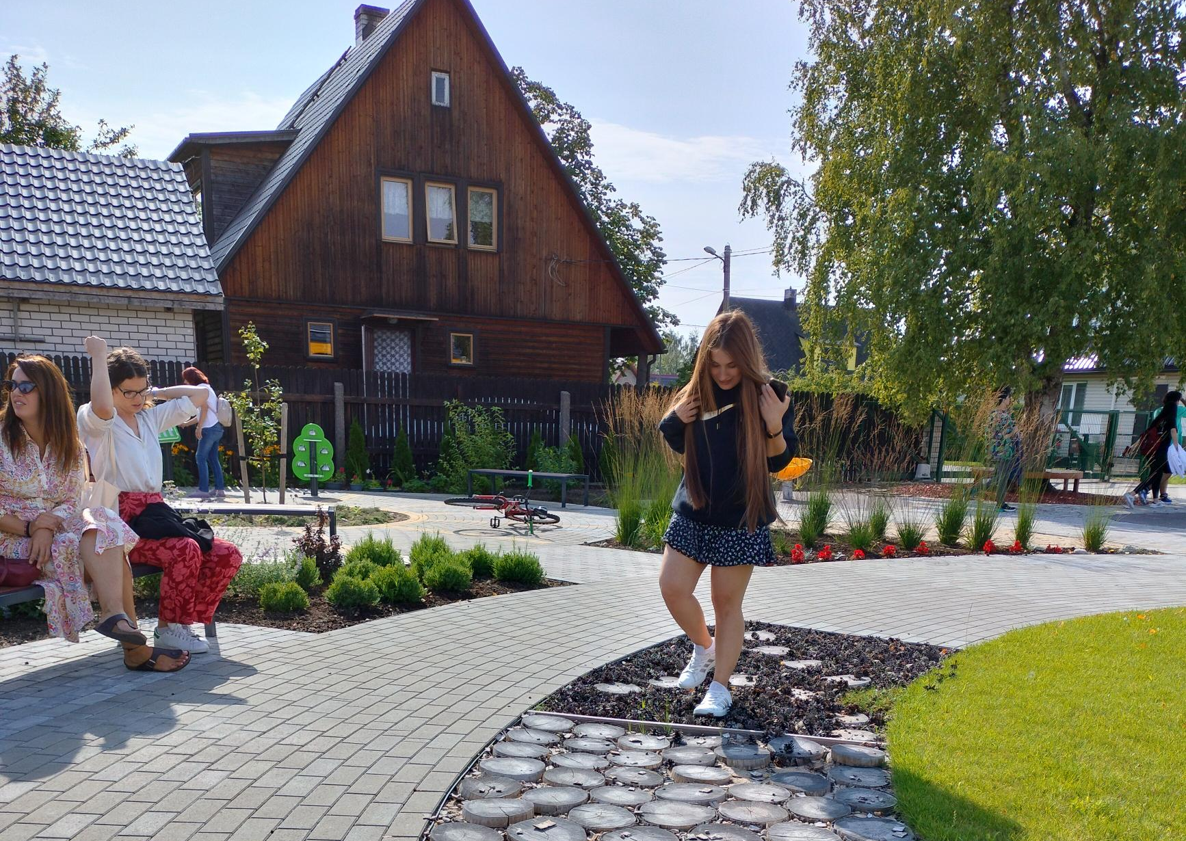
Päikese School playground
The playground is adapted for children with special needs
The picture shows a track that helps improve the perception of various structures

Slide 18
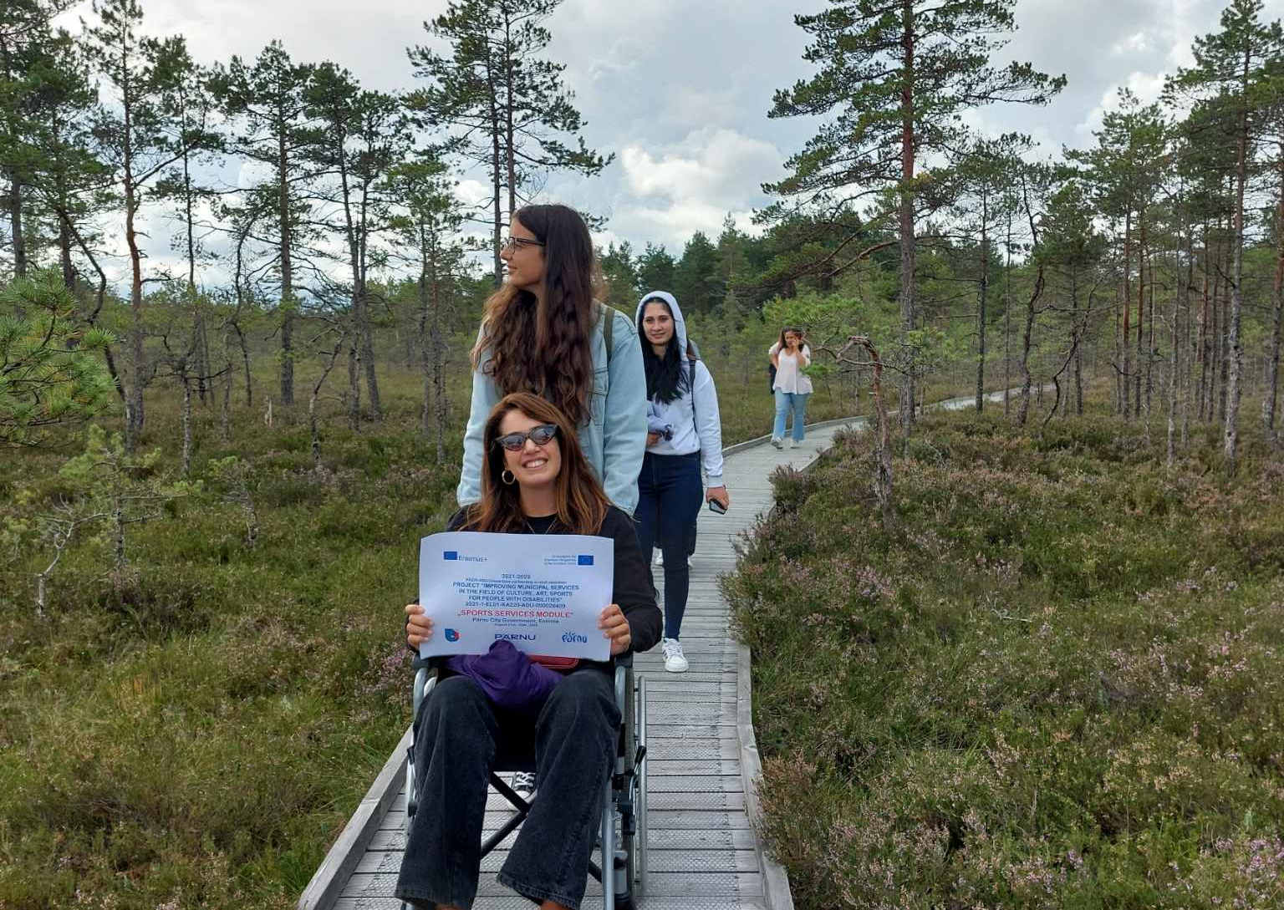
Nature access for people with reduced mobility​
Some hiking trails in Estonia are adapted to be wheelchair-accessible​
We tested with the partners from ERASMUS+ project the usability of the trail with Erasmus+ partners using a wheelchair

Slide 19
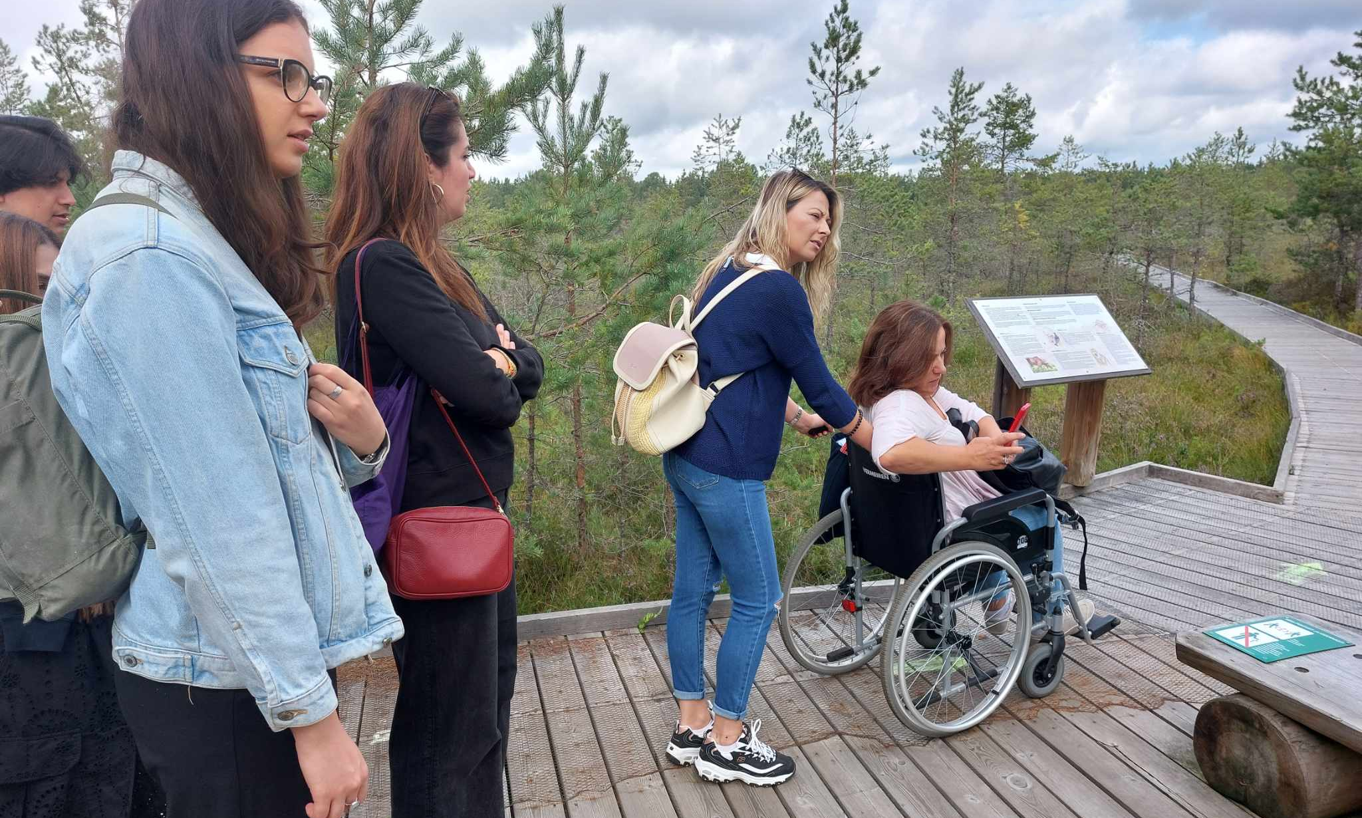

Slide 20
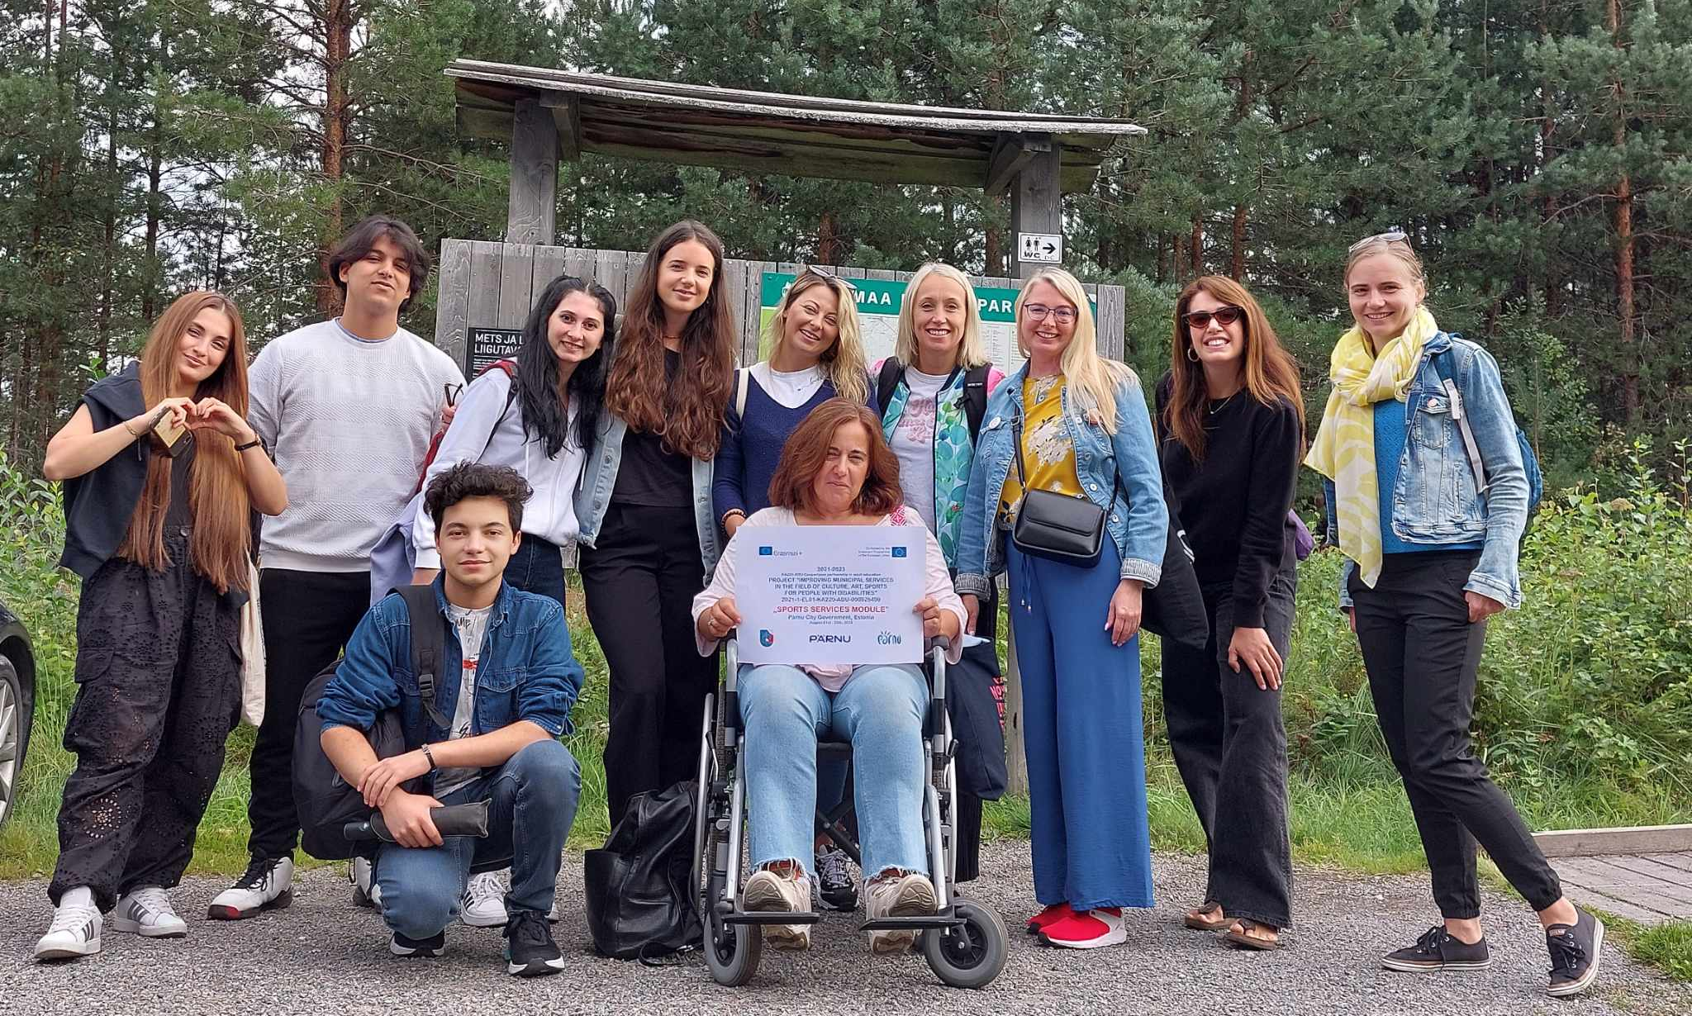

Slide 21
Cultural trip to Kihnu island
Kihnu Cultural Space was included in UNESCO’s list of Masterpieces of Oral and Intangible Heritage of Humanity in November 2003. In 2008 it was inscribed on the Representative List of the Intangible Cultural Heritage of Humanity.
Kihnu cultural space consists of Kihnu and neighbouring small island Manija. Its culture, communal lifestyle, local dialect, traditions and music are what make it unique.
We visited the local museum, church, lighthouse and enjoyed a folklore performance.

Slide 22
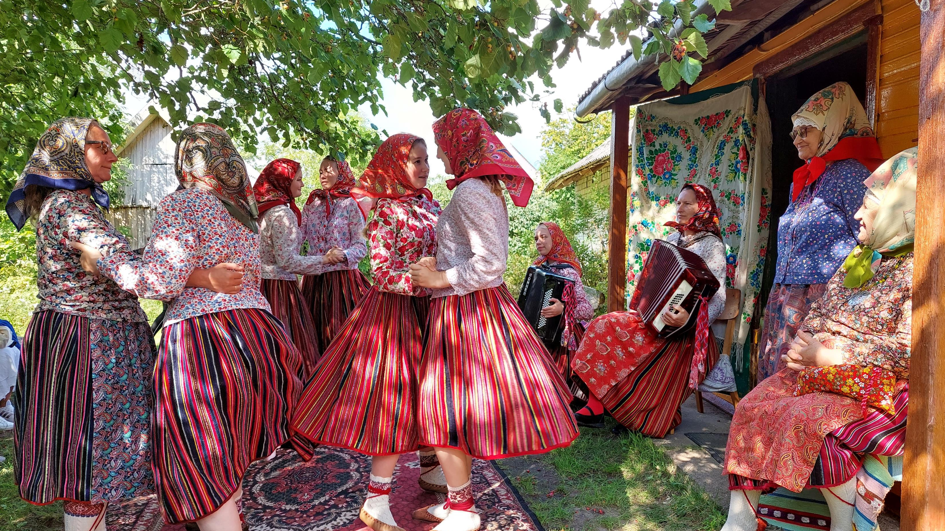

Slide 23
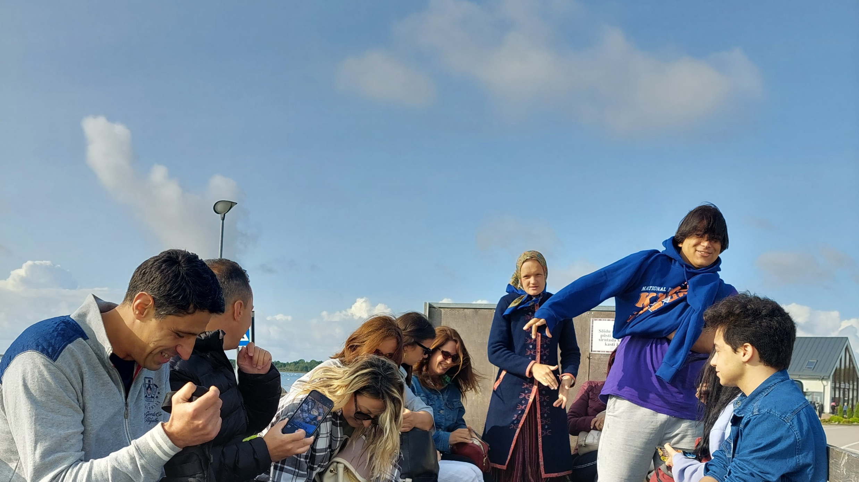
Driving around like a local in a truck bed

Slide 24
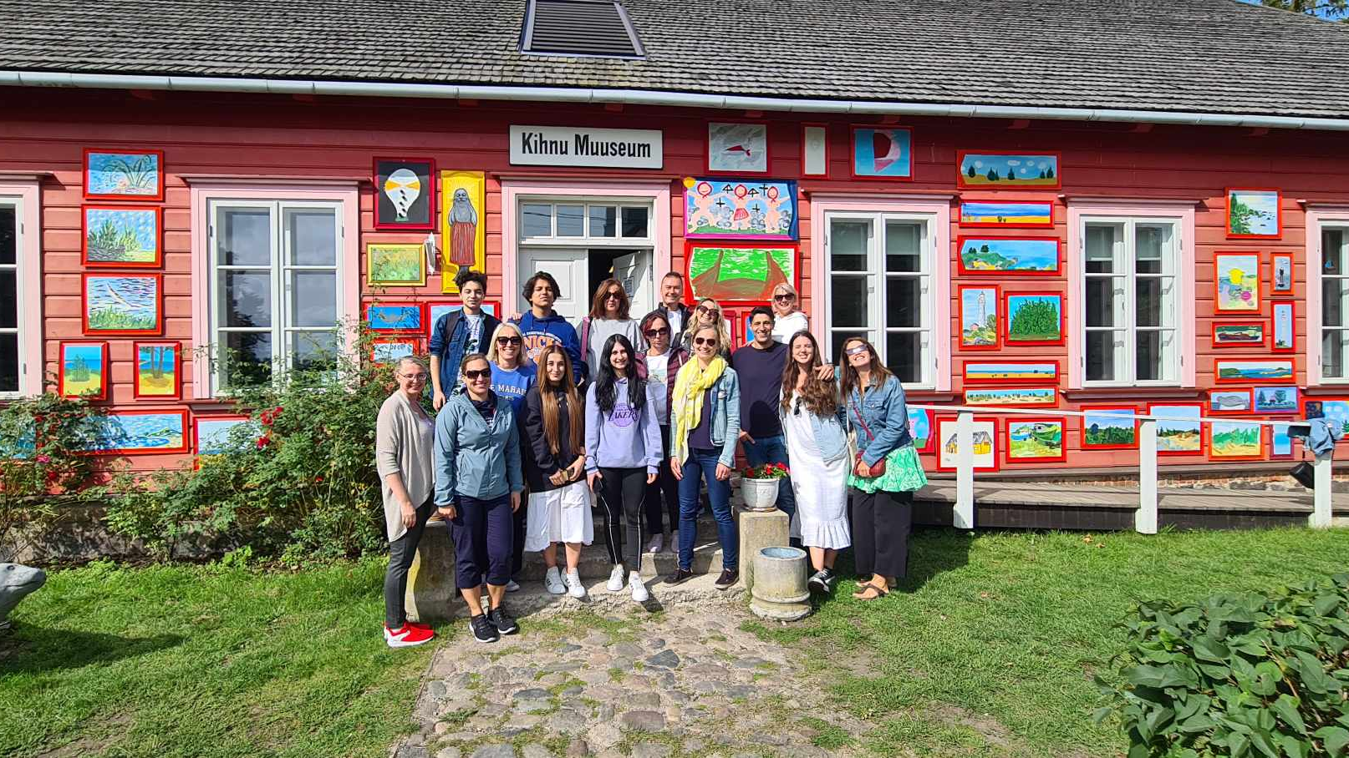
Erasmus+ project partners in front of the local museum

