Slide 1

IMPROVING MUNICIPAL SERVICES IN THE FIELD OF CULTURE, ART, SPORTS FOR PEOPLE WITH DISABILITIES
2021-1-EL01-KA220-ADU-000026409
Activity Details: (IMPROVEMENT OF CULTURE AND ARTS SERVICES / COMPETENT STAFF TRAINING)
Turkey - Antalya

Slide 2
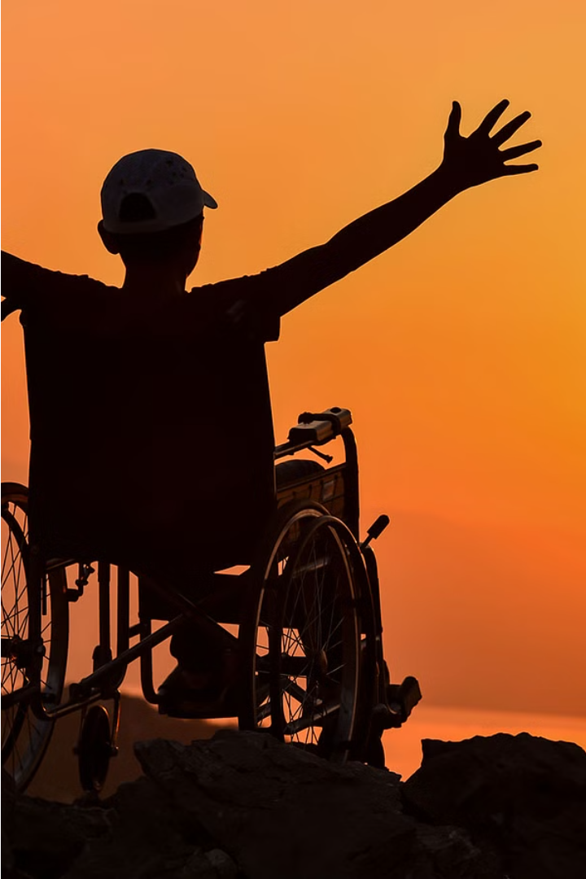
Inclusion of the Disabled in Culture and Arts
Embracing the diverse abilities of individuals with disabilities is essential for creating a truly inclusive and vibrant cultural landscape. By actively involving the disabled community in arts and cultural activities, we can foster greater understanding, accessibility, and representation.

Slide 3
The European Common Culture and Arts Education for the Disabled
Shared Arts Curriculum
Exchange of Best Practices
Across Europe, there are efforts to create a common arts curriculum that is inclusive and accessible to students with disabilities.
European nations collaborate to share successful teaching methods and program models that promote equal participation in cultural activities.
Disability-Focused Arts Institutes
Integrated Classrooms
Arts education increasingly takes place in classrooms that integrate students with and without disabilities, fostering understanding and inclusion.
Specialized arts schools and programs cater to the unique needs and talents of aspiring disabled artists and performers.

Slide 4

Importance of Inclusive Culture and Arts Activities
Inclusive culture and arts activities are essential for fostering a more equitable and diverse society. They provide opportunities for the disabled to actively participate, express themselves, and contribute to the cultural fabric. This promotes understanding, breaks down stereotypes, and empowers the disabled community.
Engaging the disabled in the arts cultivates a sense of belonging, boosts self-confidence, and enhances overall well-being. Through inclusive programs, the disabled can share their unique perspectives and celebrate their creativity, creating a more vibrant and representative cultural landscape.

Slide 5
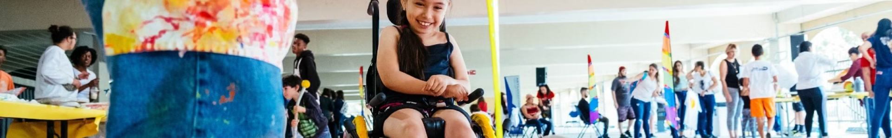
Organizing Activity Environments for the Disabled
1
Accessibility
2
Sensory Needs
3
Inclusive Design

Slide 6

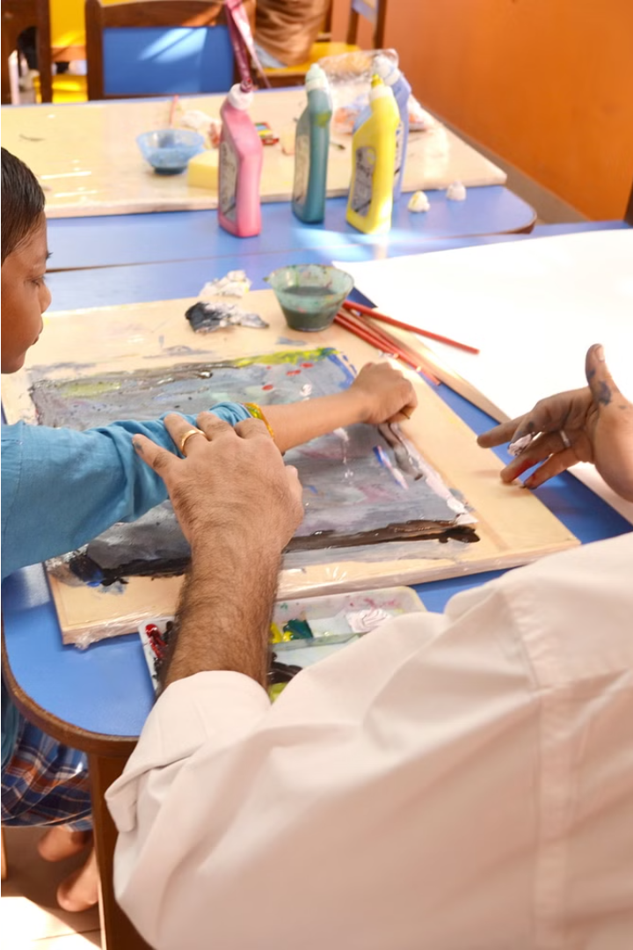
Teaching Methods and Techniques for Disabled Participants
Inclusive arts education requires specialized teaching methods to accommodate diverse needs. Hands-on activities, multisensory approaches, and assistive technologies can empower disabled students to express themselves creatively.
Instructors should receive training in Universal Design for Learning to ensure their lessons are accessible and engaging for all participants.

Slide 7
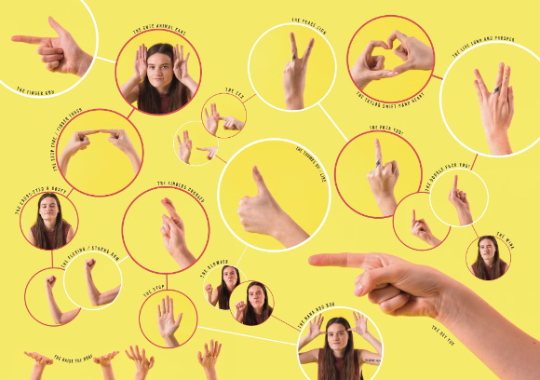
Effective Communication Strategies with the Disabled
Effective communication is crucial for including the disabled in cultural and arts activities. This involves using plain language, visual aids, and active listening to ensure mutual understanding.
Providing sign language interpreters, captioning, and audio descriptions can also help overcome communication barriers. Fostering an environment of patience, empathy, and inclusion is key.

Slide 8
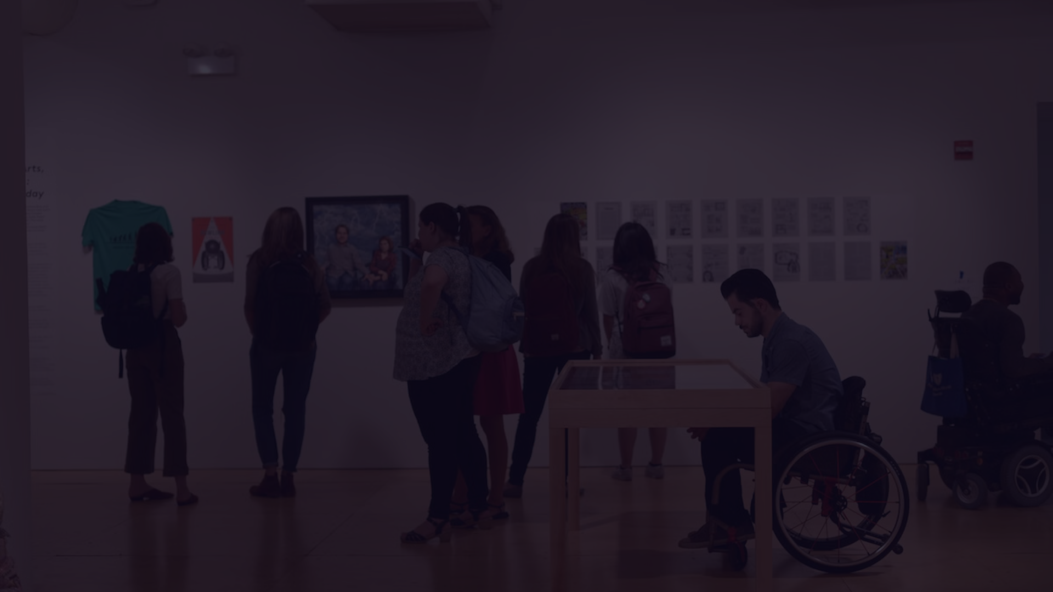



Overcoming Barriers to Inclusion in Culture and Arts
Accessibility
Stigma Reduction
Collaborative Design
Ensure venues, exhibits, and events have accommodations like ramps, elevators, and assistive technologies to enable full participation.
Challenge negative stereotypes and misconceptions about the disabled through educational campaigns and inclusive representations in the arts.
Involve the disabled community in planning and designing cultural programs to create truly accessible and engaging experiences.

Slide 9



Empowering the Disabled Through Artistic Expression
Unleash Creativity
1
Discover hidden talents and passions
Build Confidence
2
Celebrate achievements and self-worth
Foster Inclusion
3
Contribute to a more inclusive cultural landscape
Engaging the disabled community in cultural and artistic activities empowers them to unleash their creativity, build confidence, and foster a sense of inclusion. Through various art forms like painting, music, dance, and theater, the disabled can express themselves, explore their unique perspectives, and showcase their talents to the world.

Slide 10

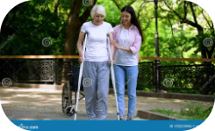
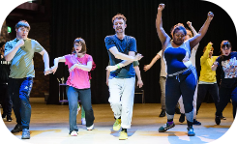
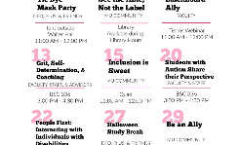
Collaboration and Partnerships for Inclusive Programs
Nonprofit Partnerships
Volunteer Engagement
Community Involvement
Cross-Sector Collaboration
Collaborating with disability-focused nonprofits can provide essential expertise, resources, and community connections to develop inclusive arts and culture programs.
Engaging volunteers from the local community to assist with inclusive activities can foster a spirit of inclusion and accessibility.
Partnering with disabled advocacy groups and inviting their members to participate in program design and delivery can ensure programs meet the unique needs of the community.
Coordinating with other sectors like education, tourism, and public services can expand the reach and impact of inclusive arts and culture initiatives.

Slide 11
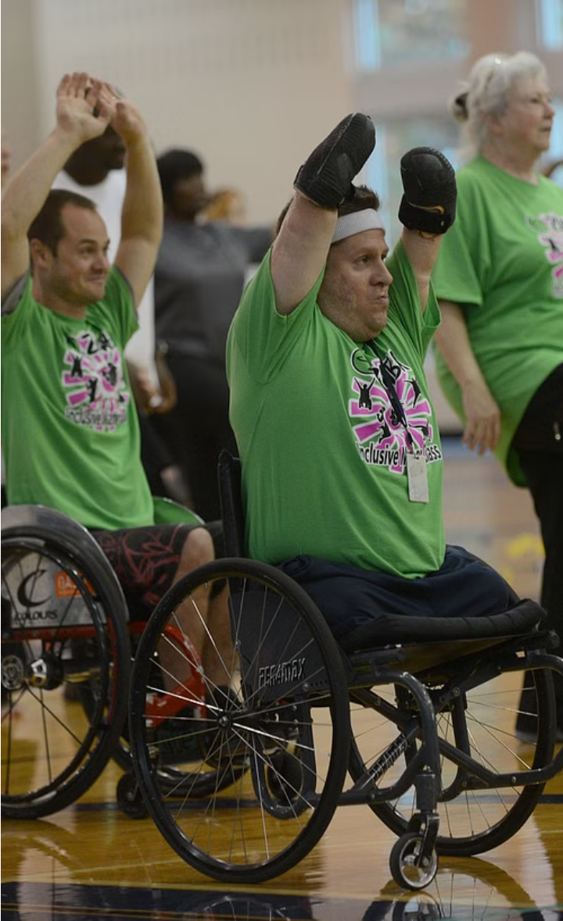
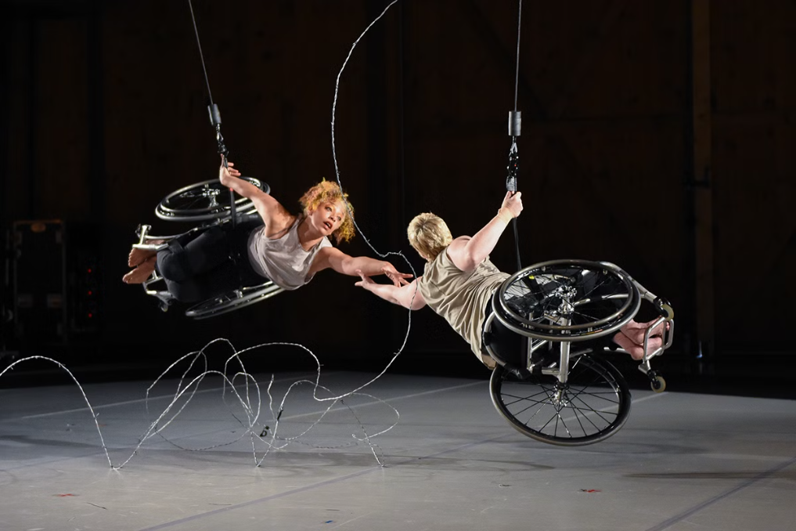
Fostering a More Inclusive Cultural Landscape
Achieving a truly inclusive cultural landscape requires a multifaceted approach. By providing equitable access, dismantling physical and attitudinal barriers, and empowering the disabled community to engage with the arts, we can create a vibrant, diverse cultural ecosystem that celebrates the creativity and contributions of all.

